Slide 1
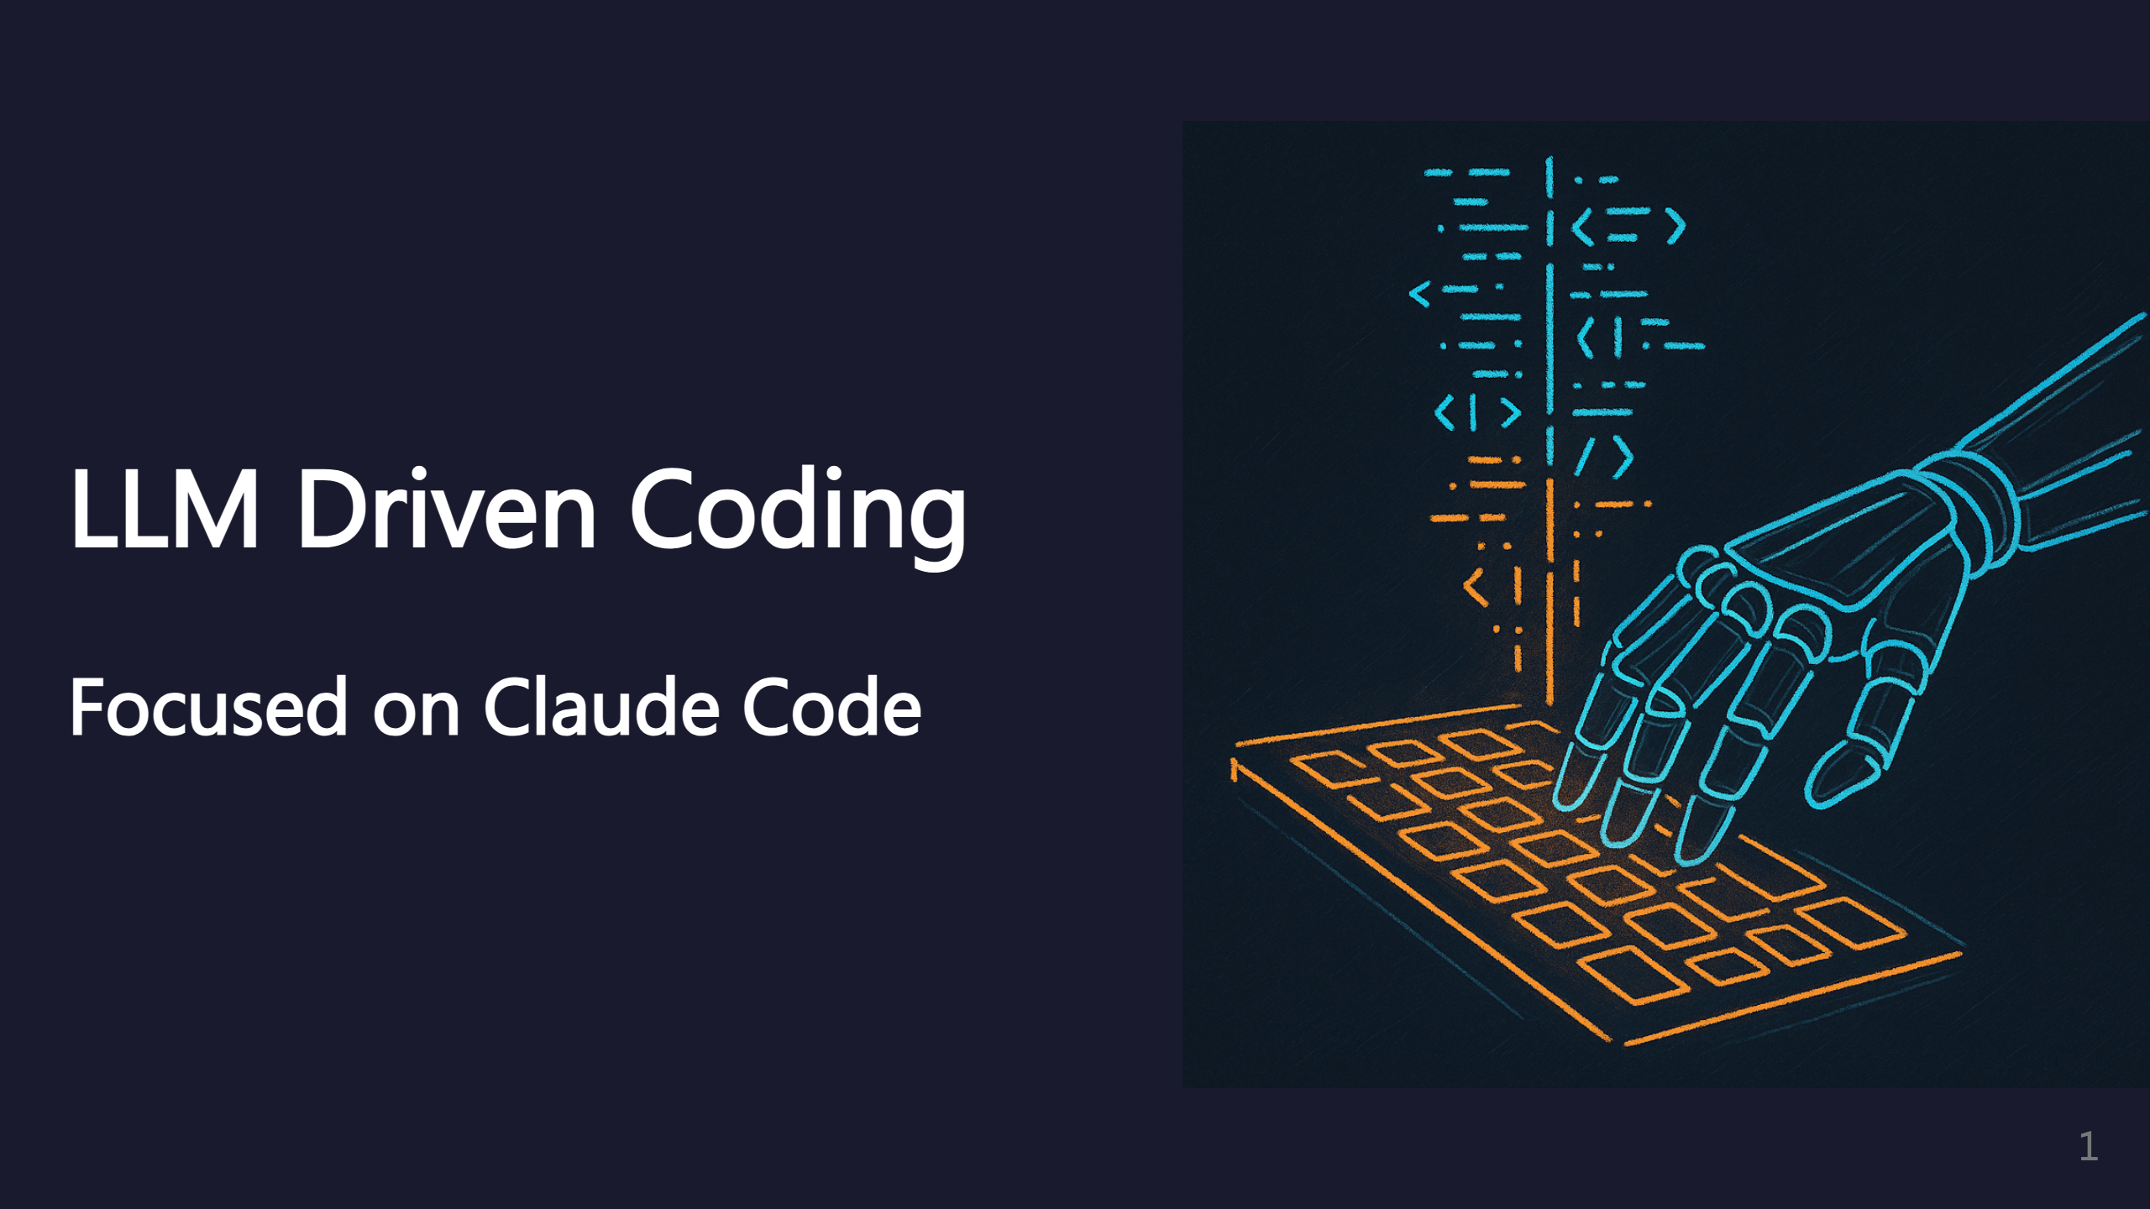
Notes:
Speaker note: These ideas will likely apply to other AI coding agents too. _transition: push

Slide 2
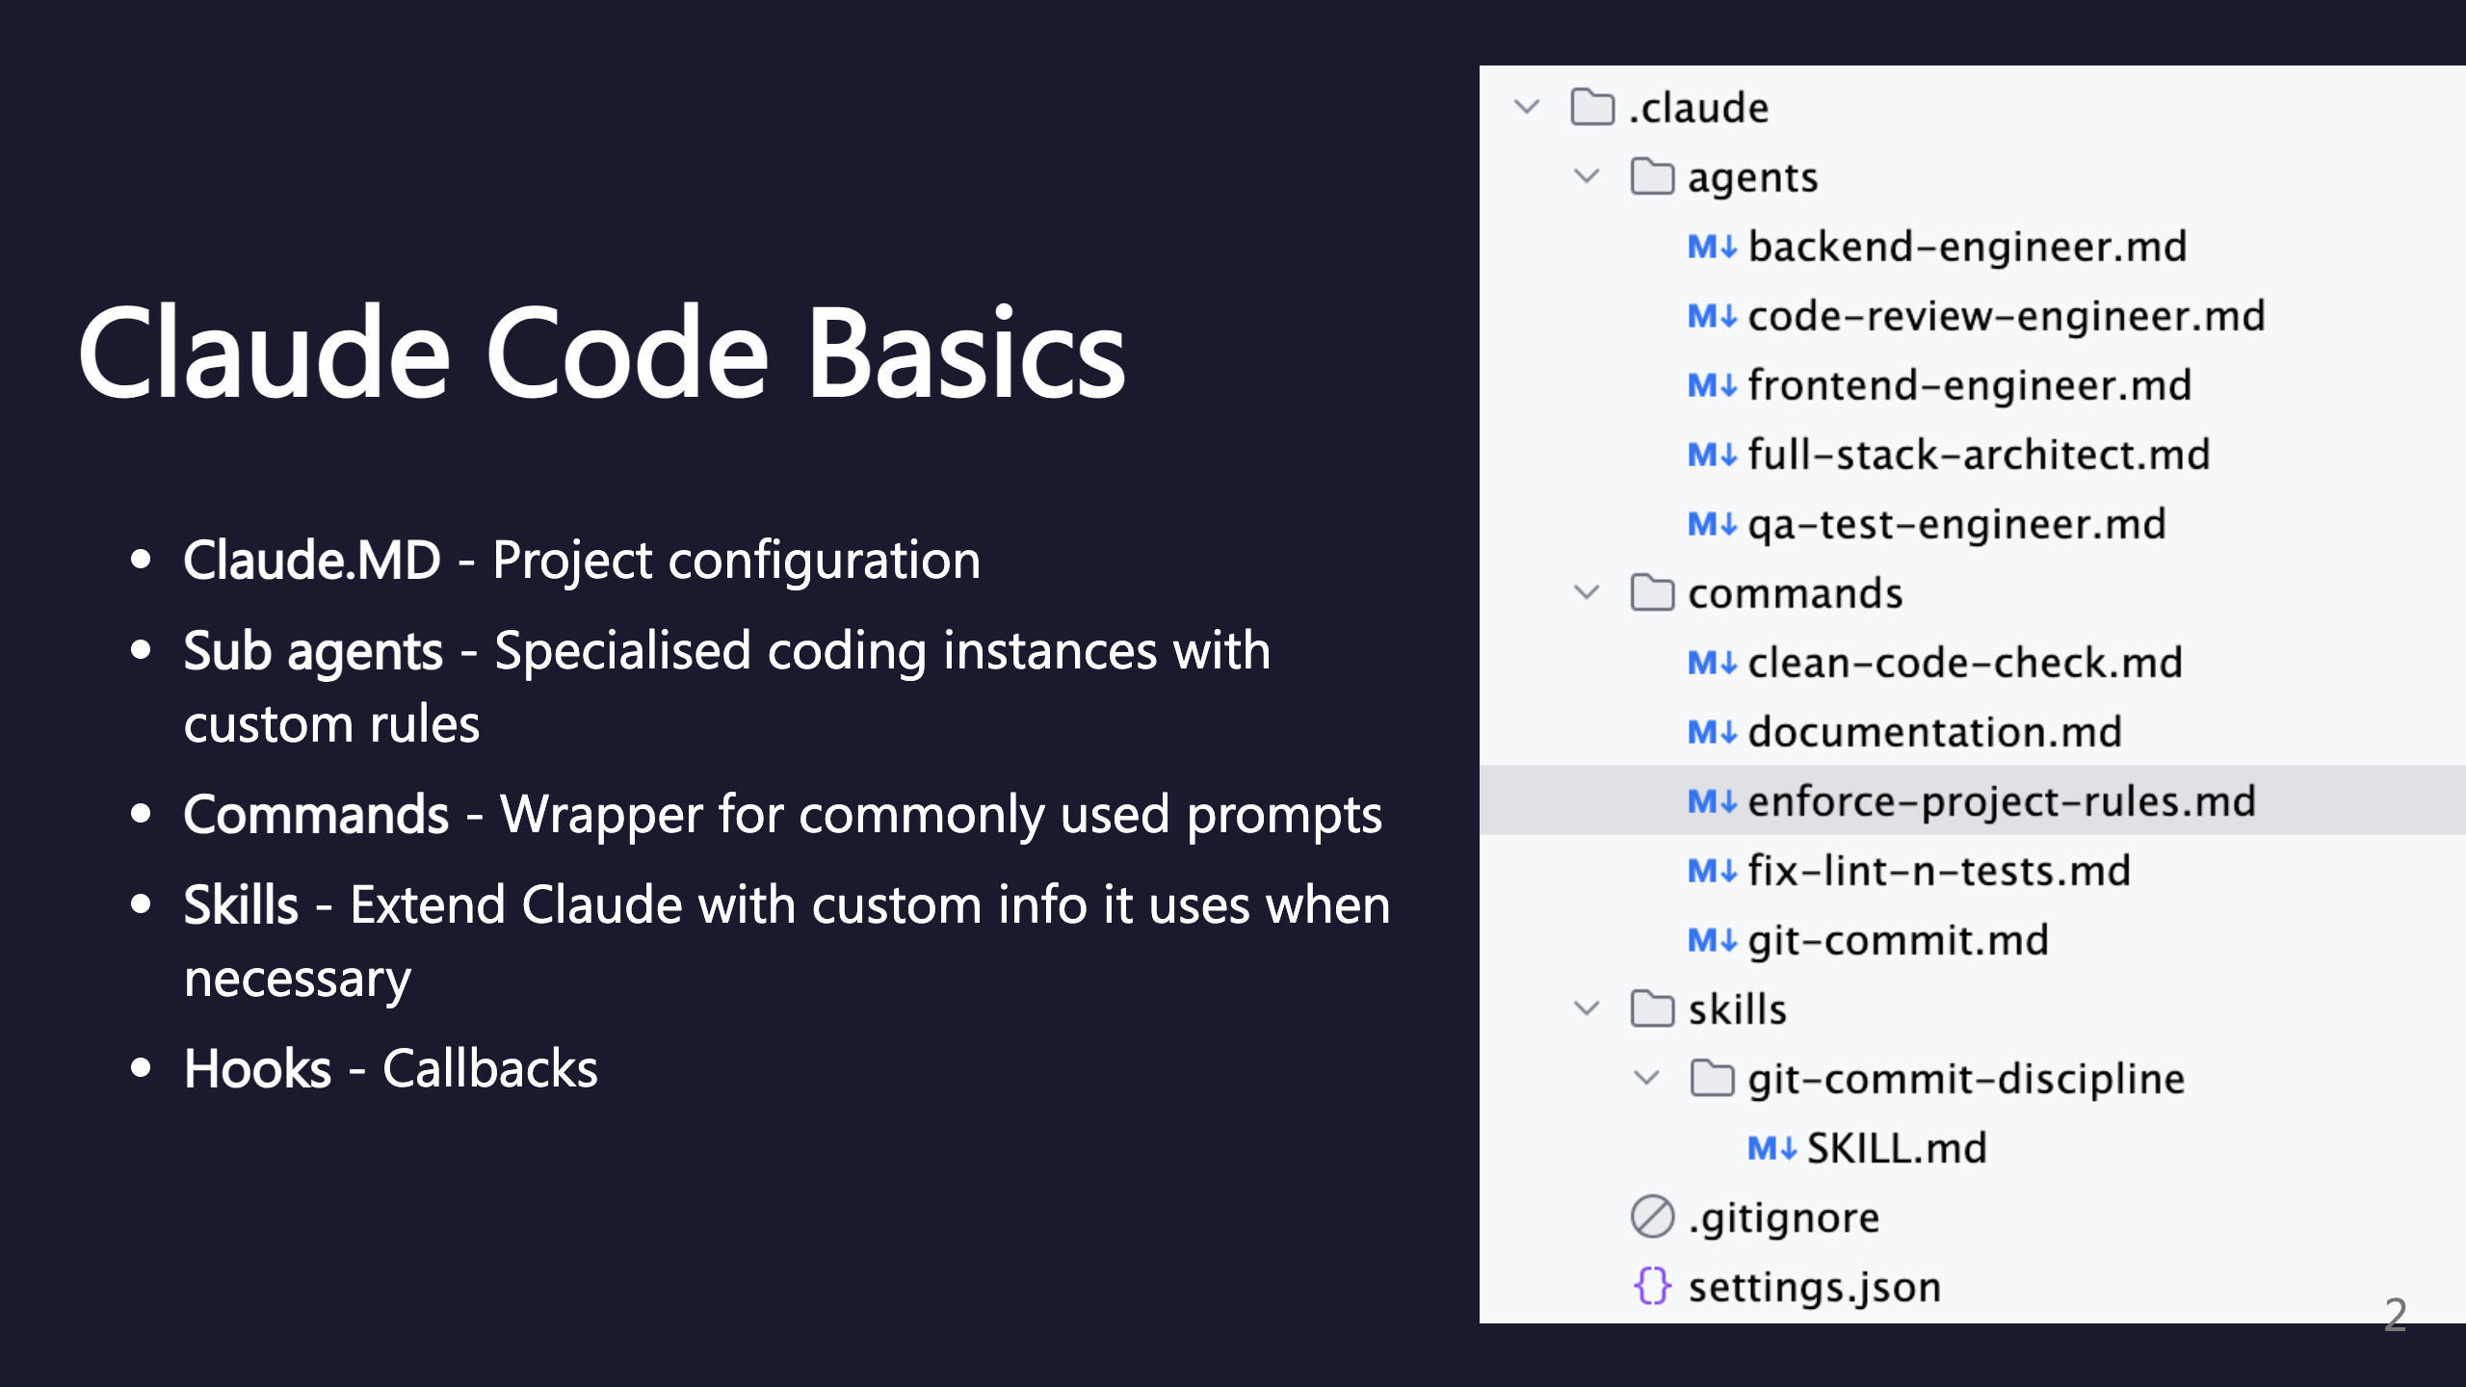
Notes:
SECTION: Claude Code Basics

Slide 3
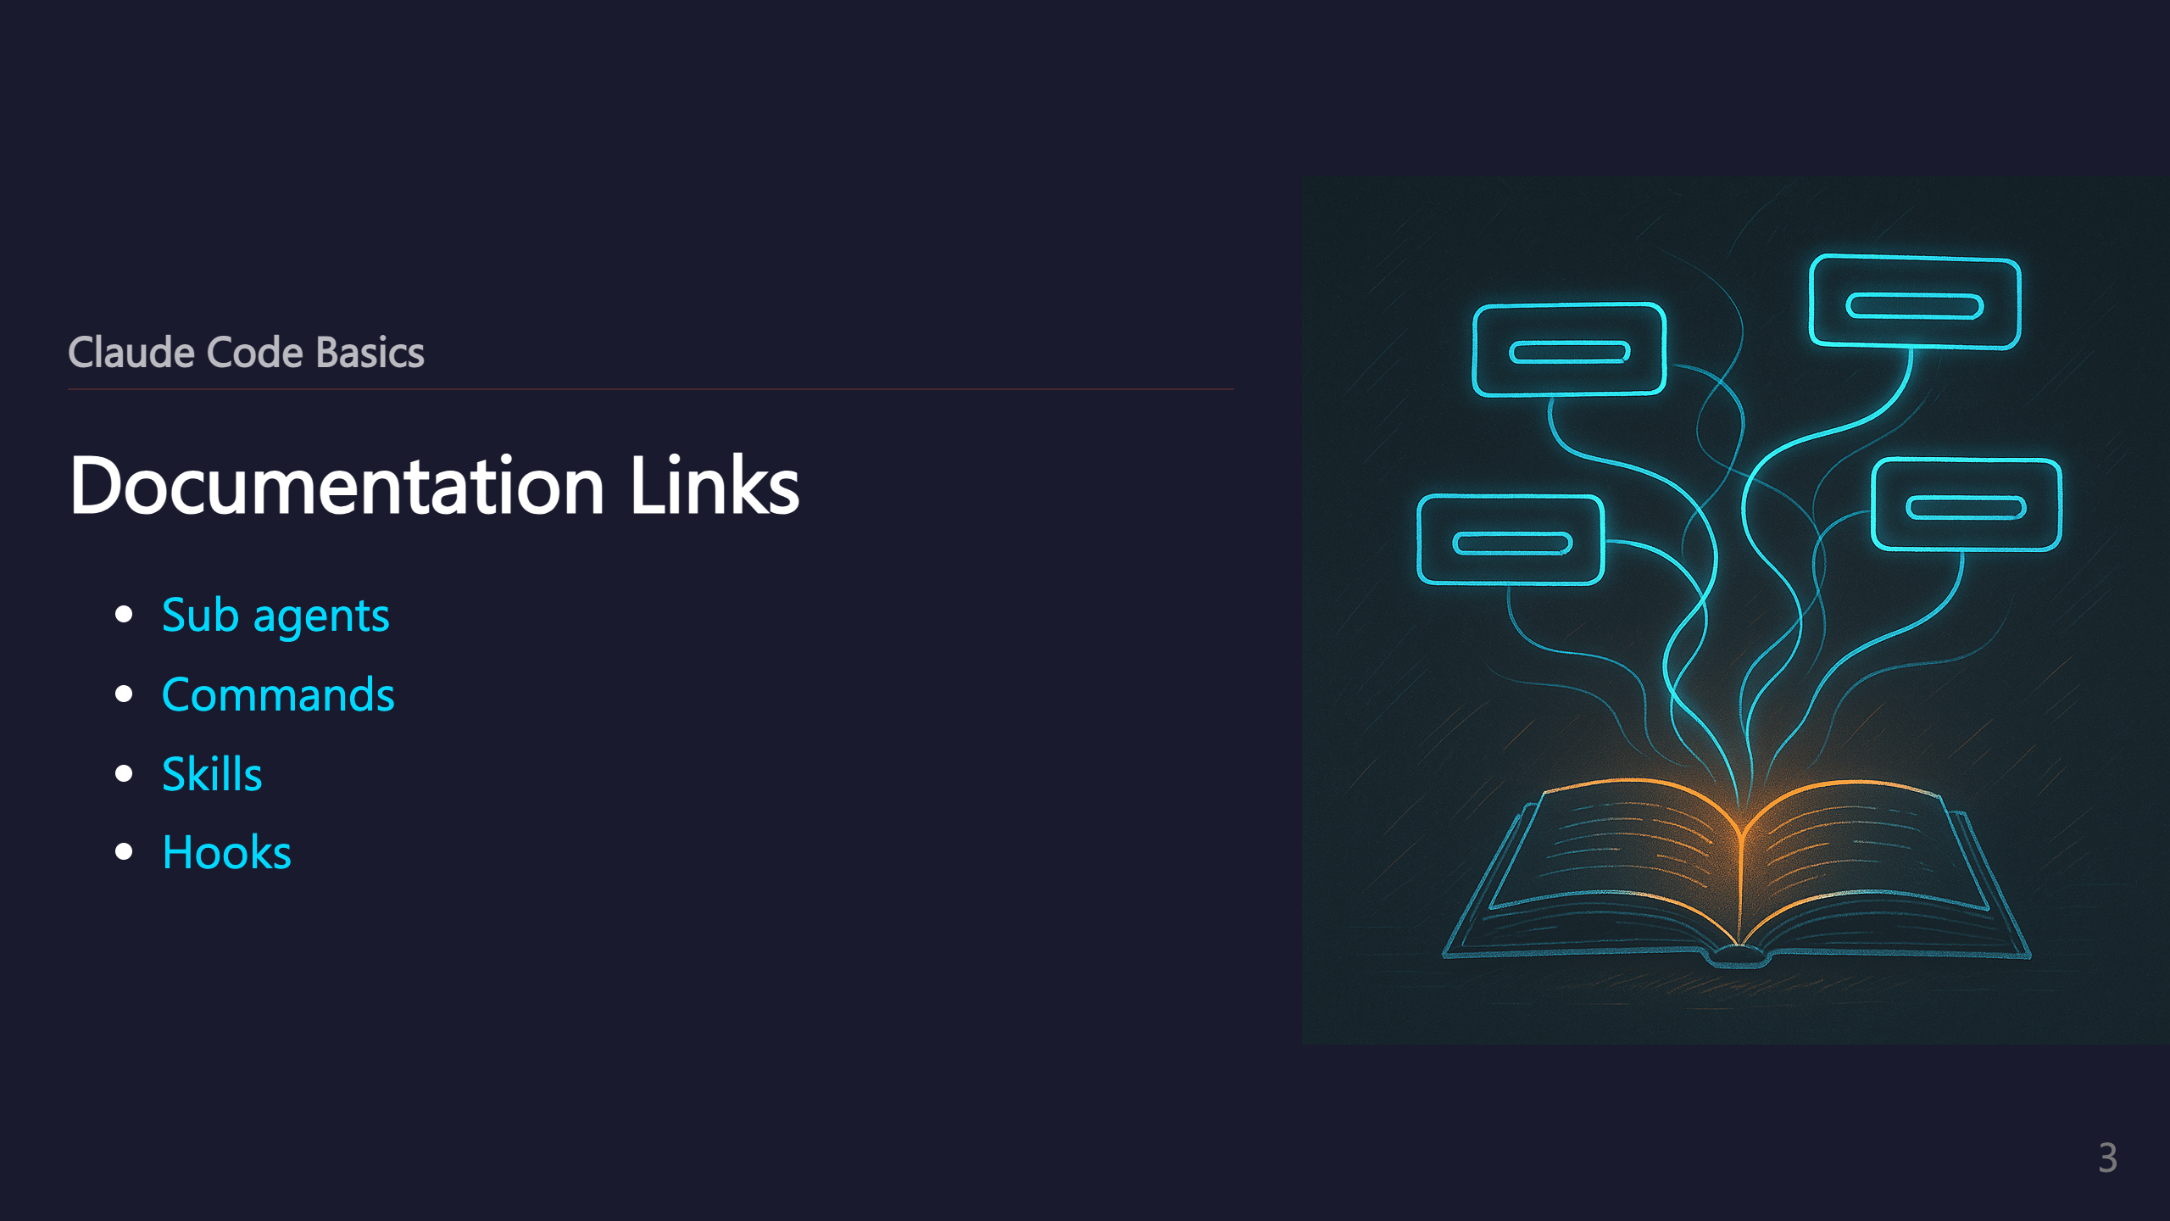
Notes:
_transition: push

Slide 4
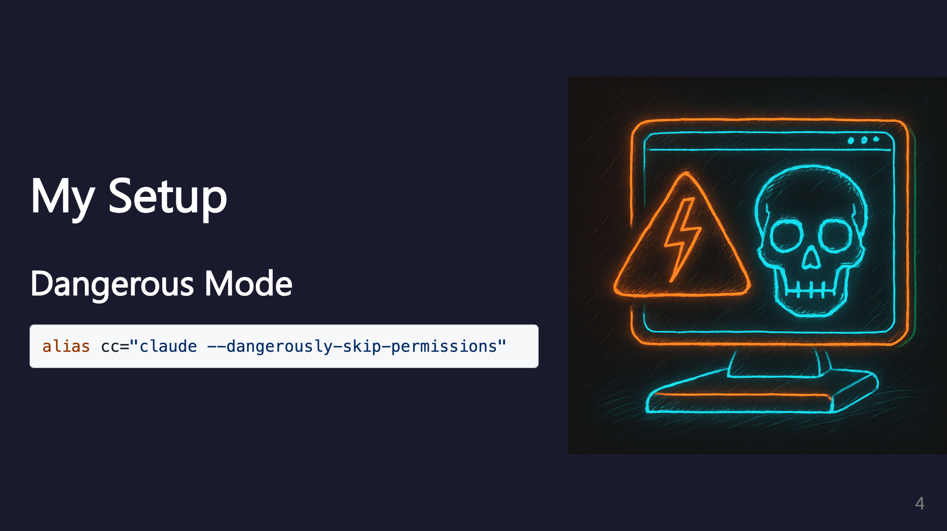
Notes:
SECTION: My Setup

Slide 5
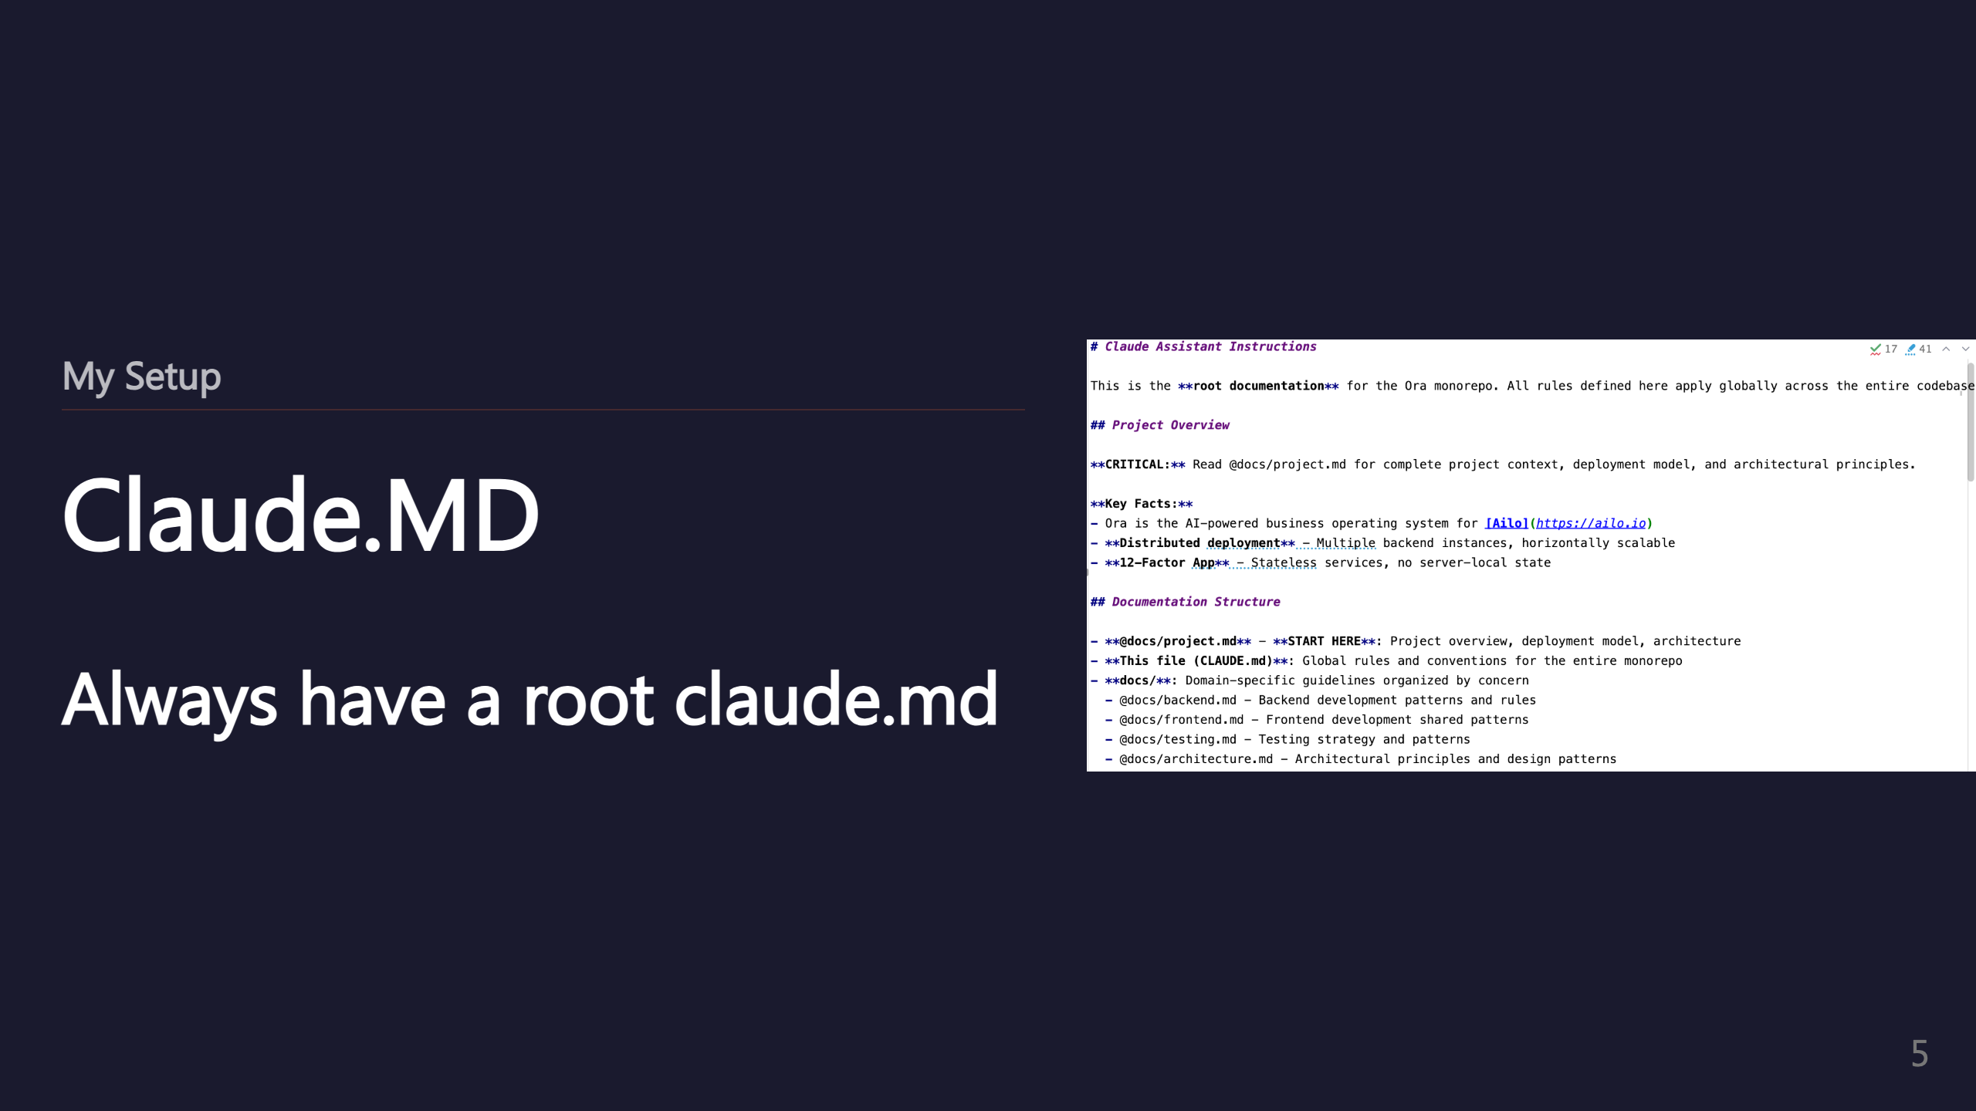
Notes:
SUBSECTION: Claude.MD

Slide 6
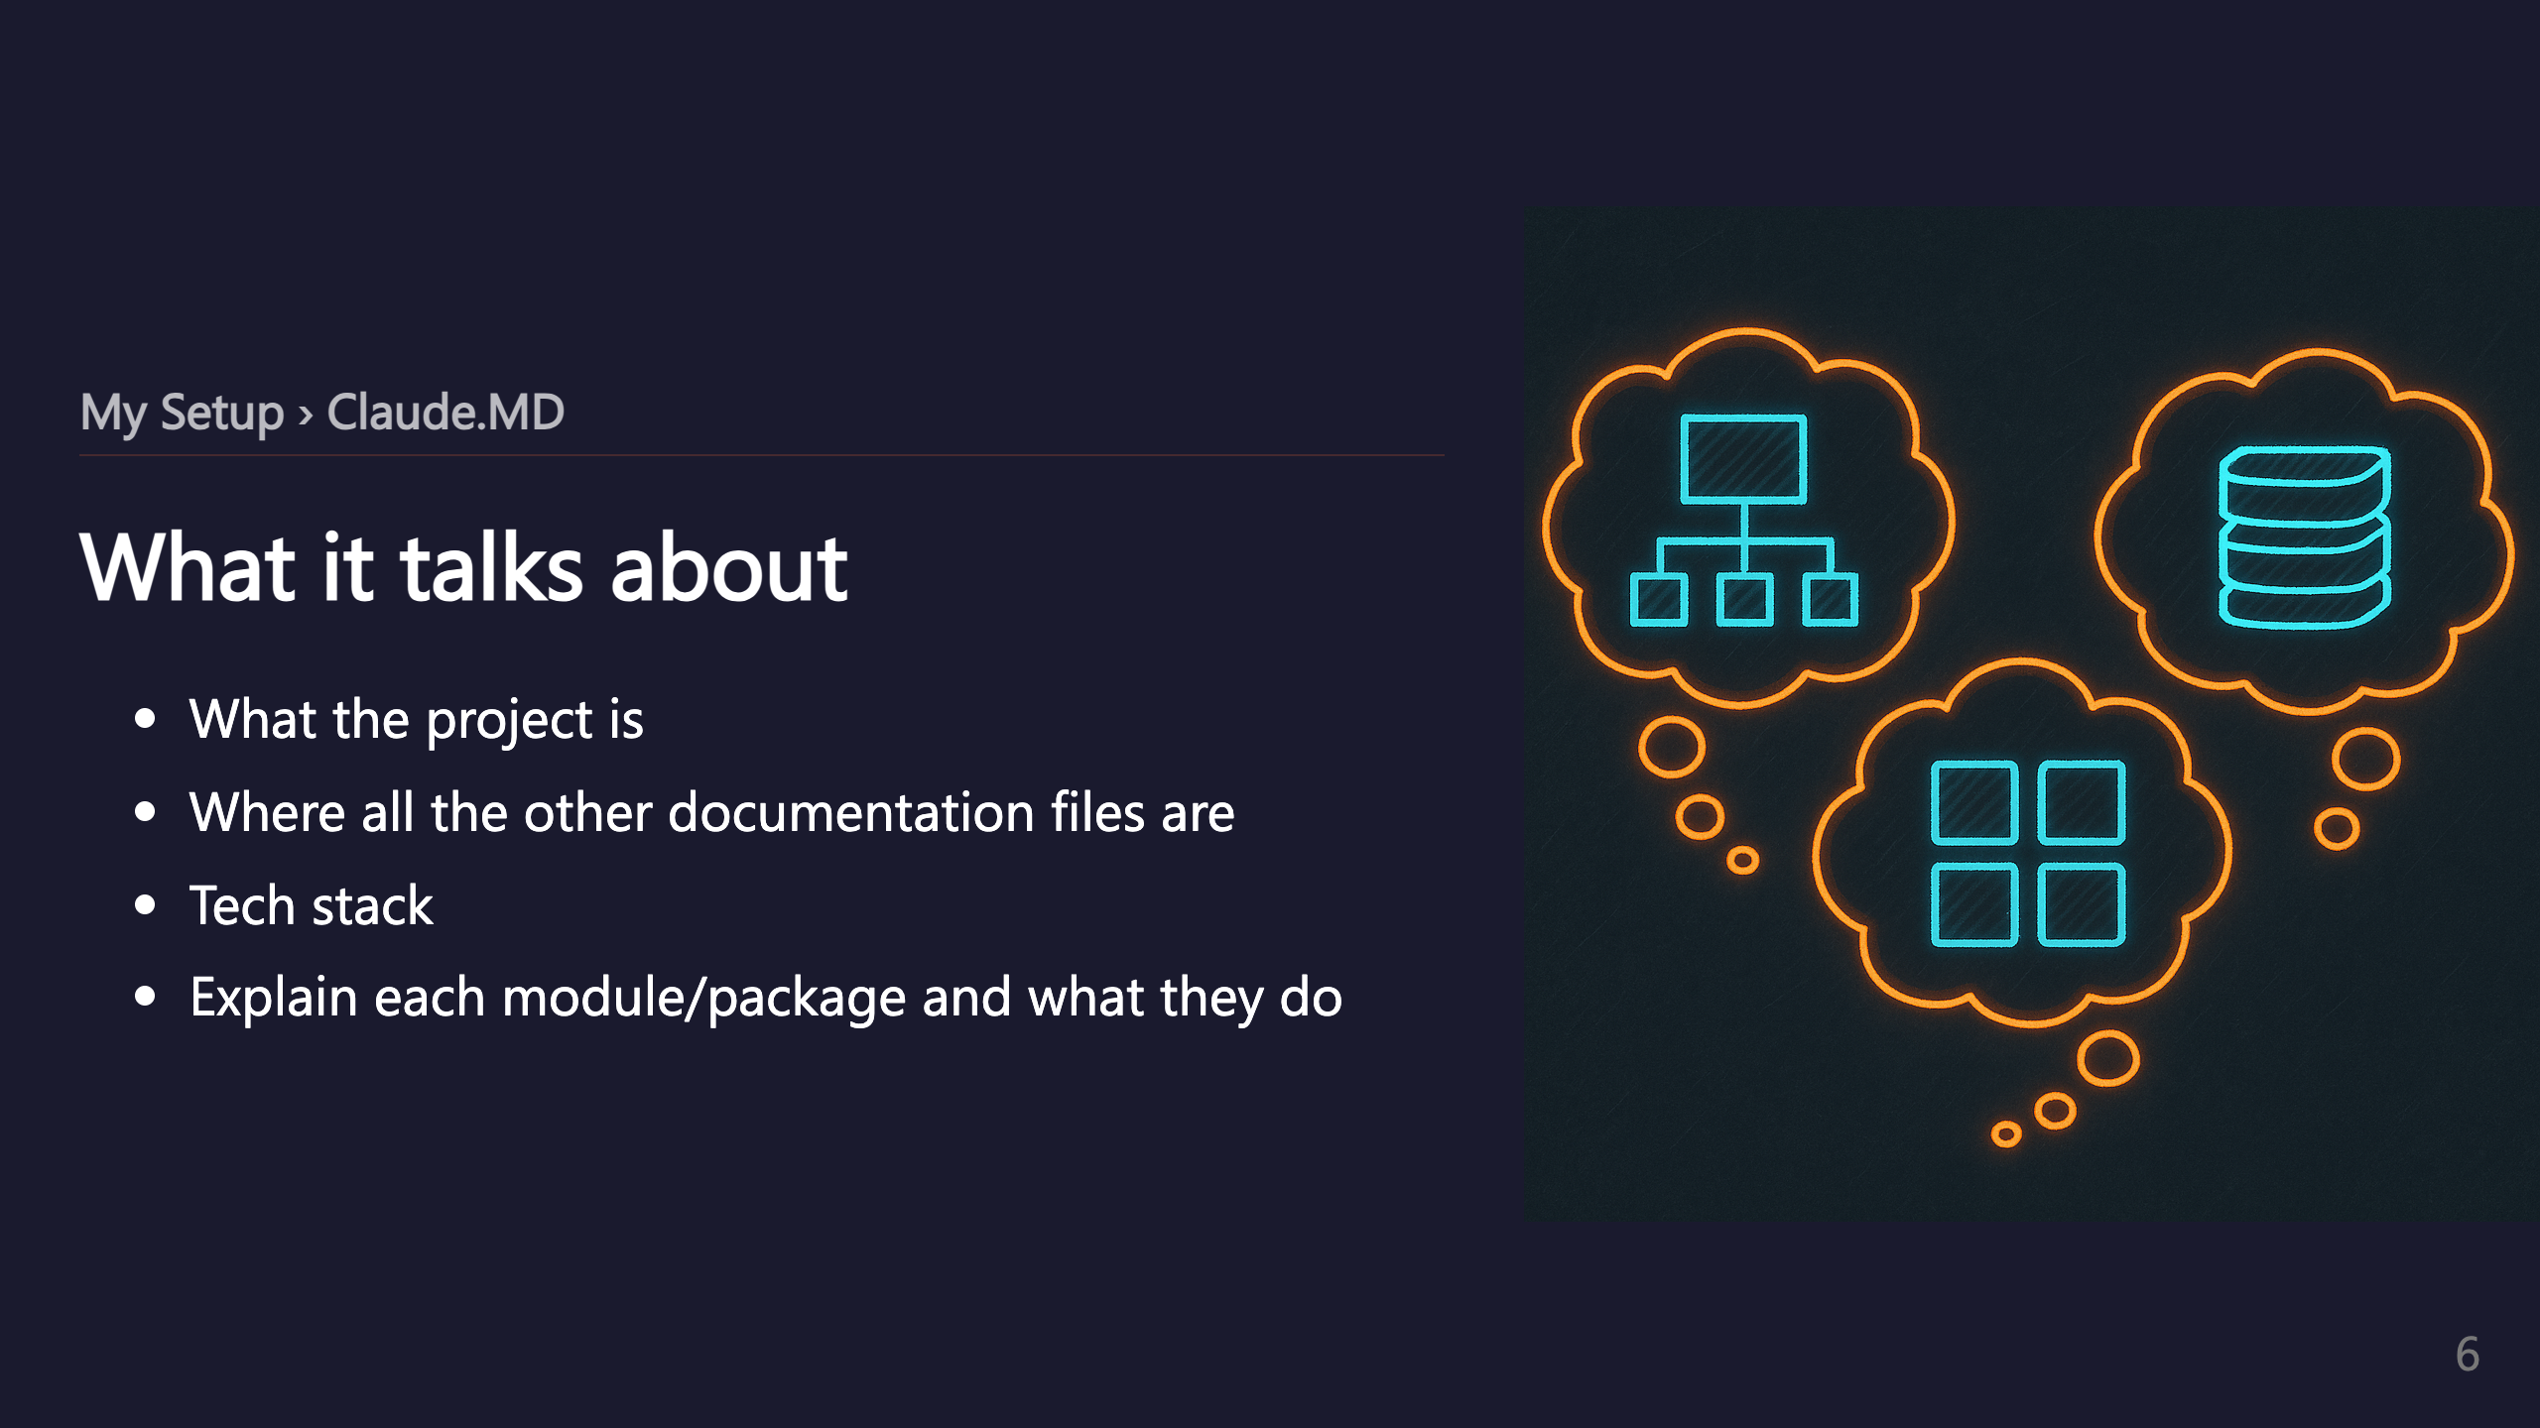

Slide 7
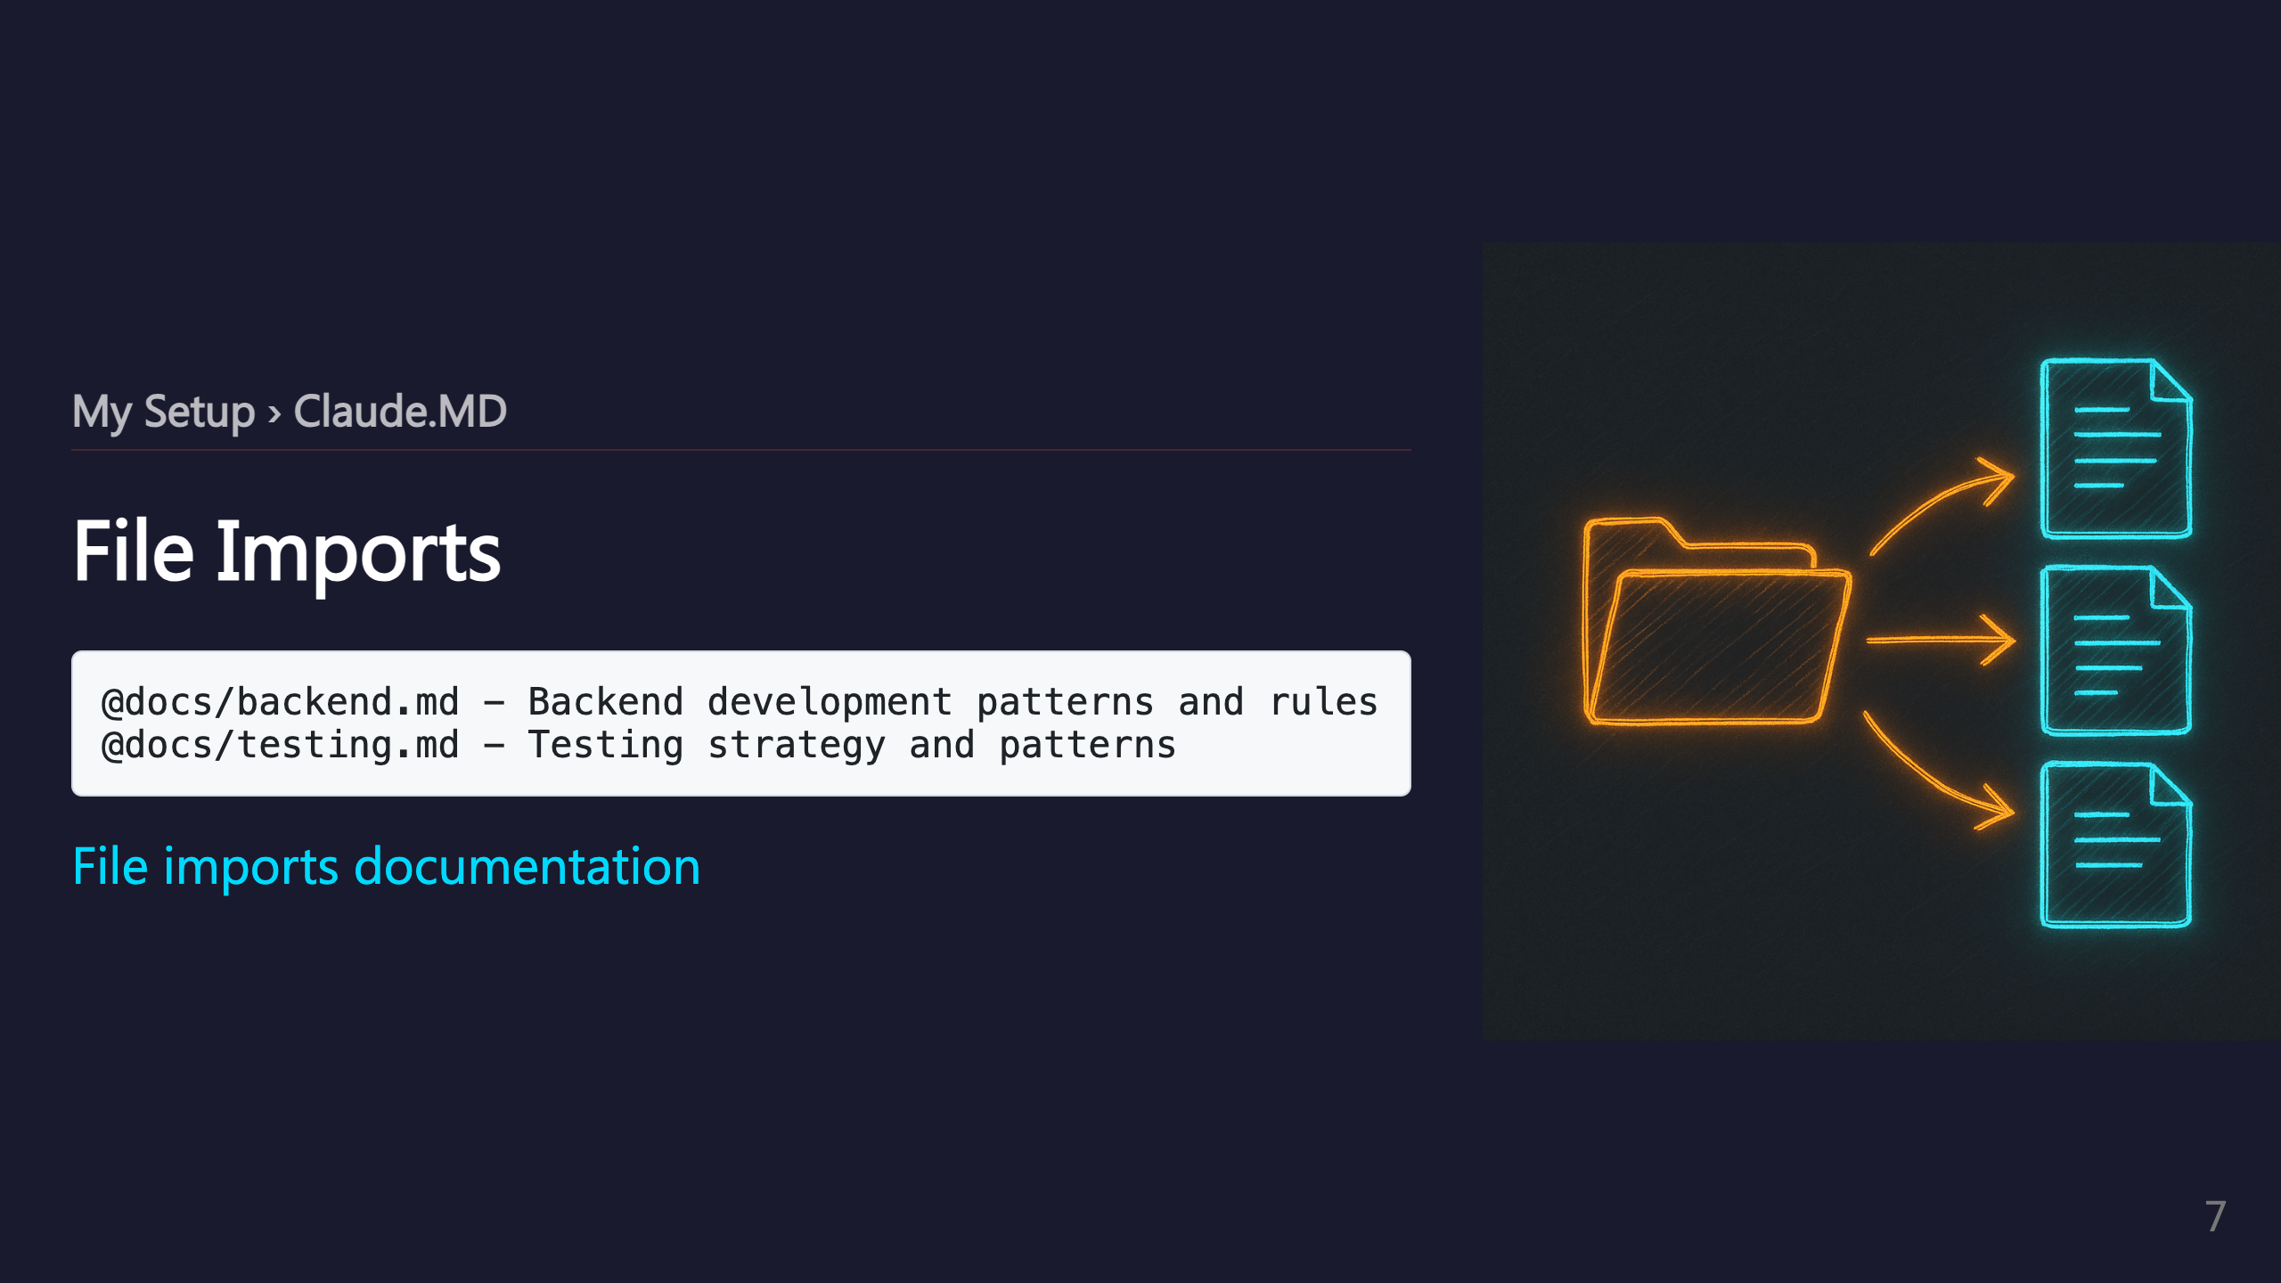

Slide 8
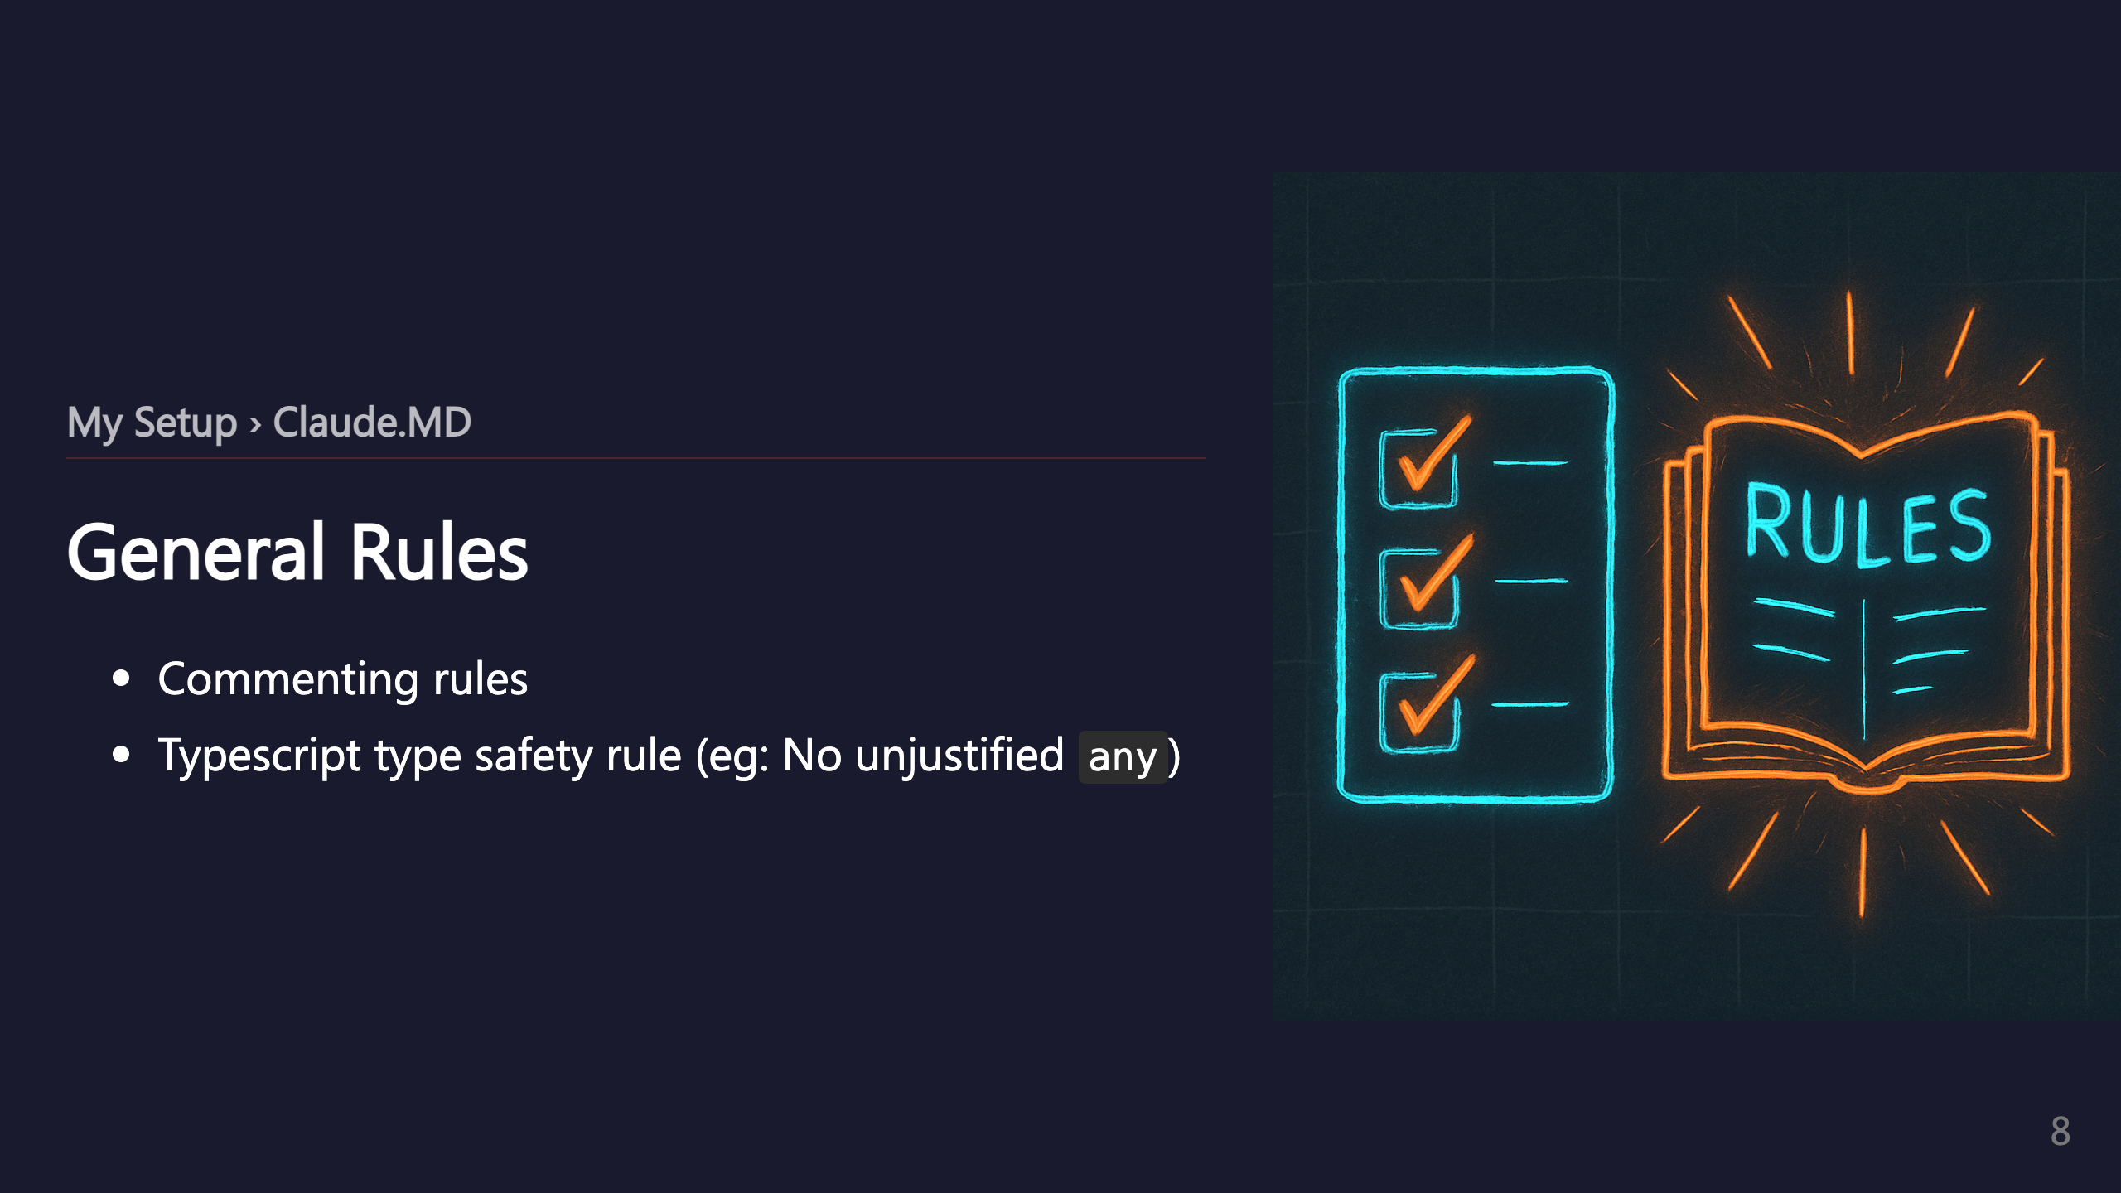

Slide 9
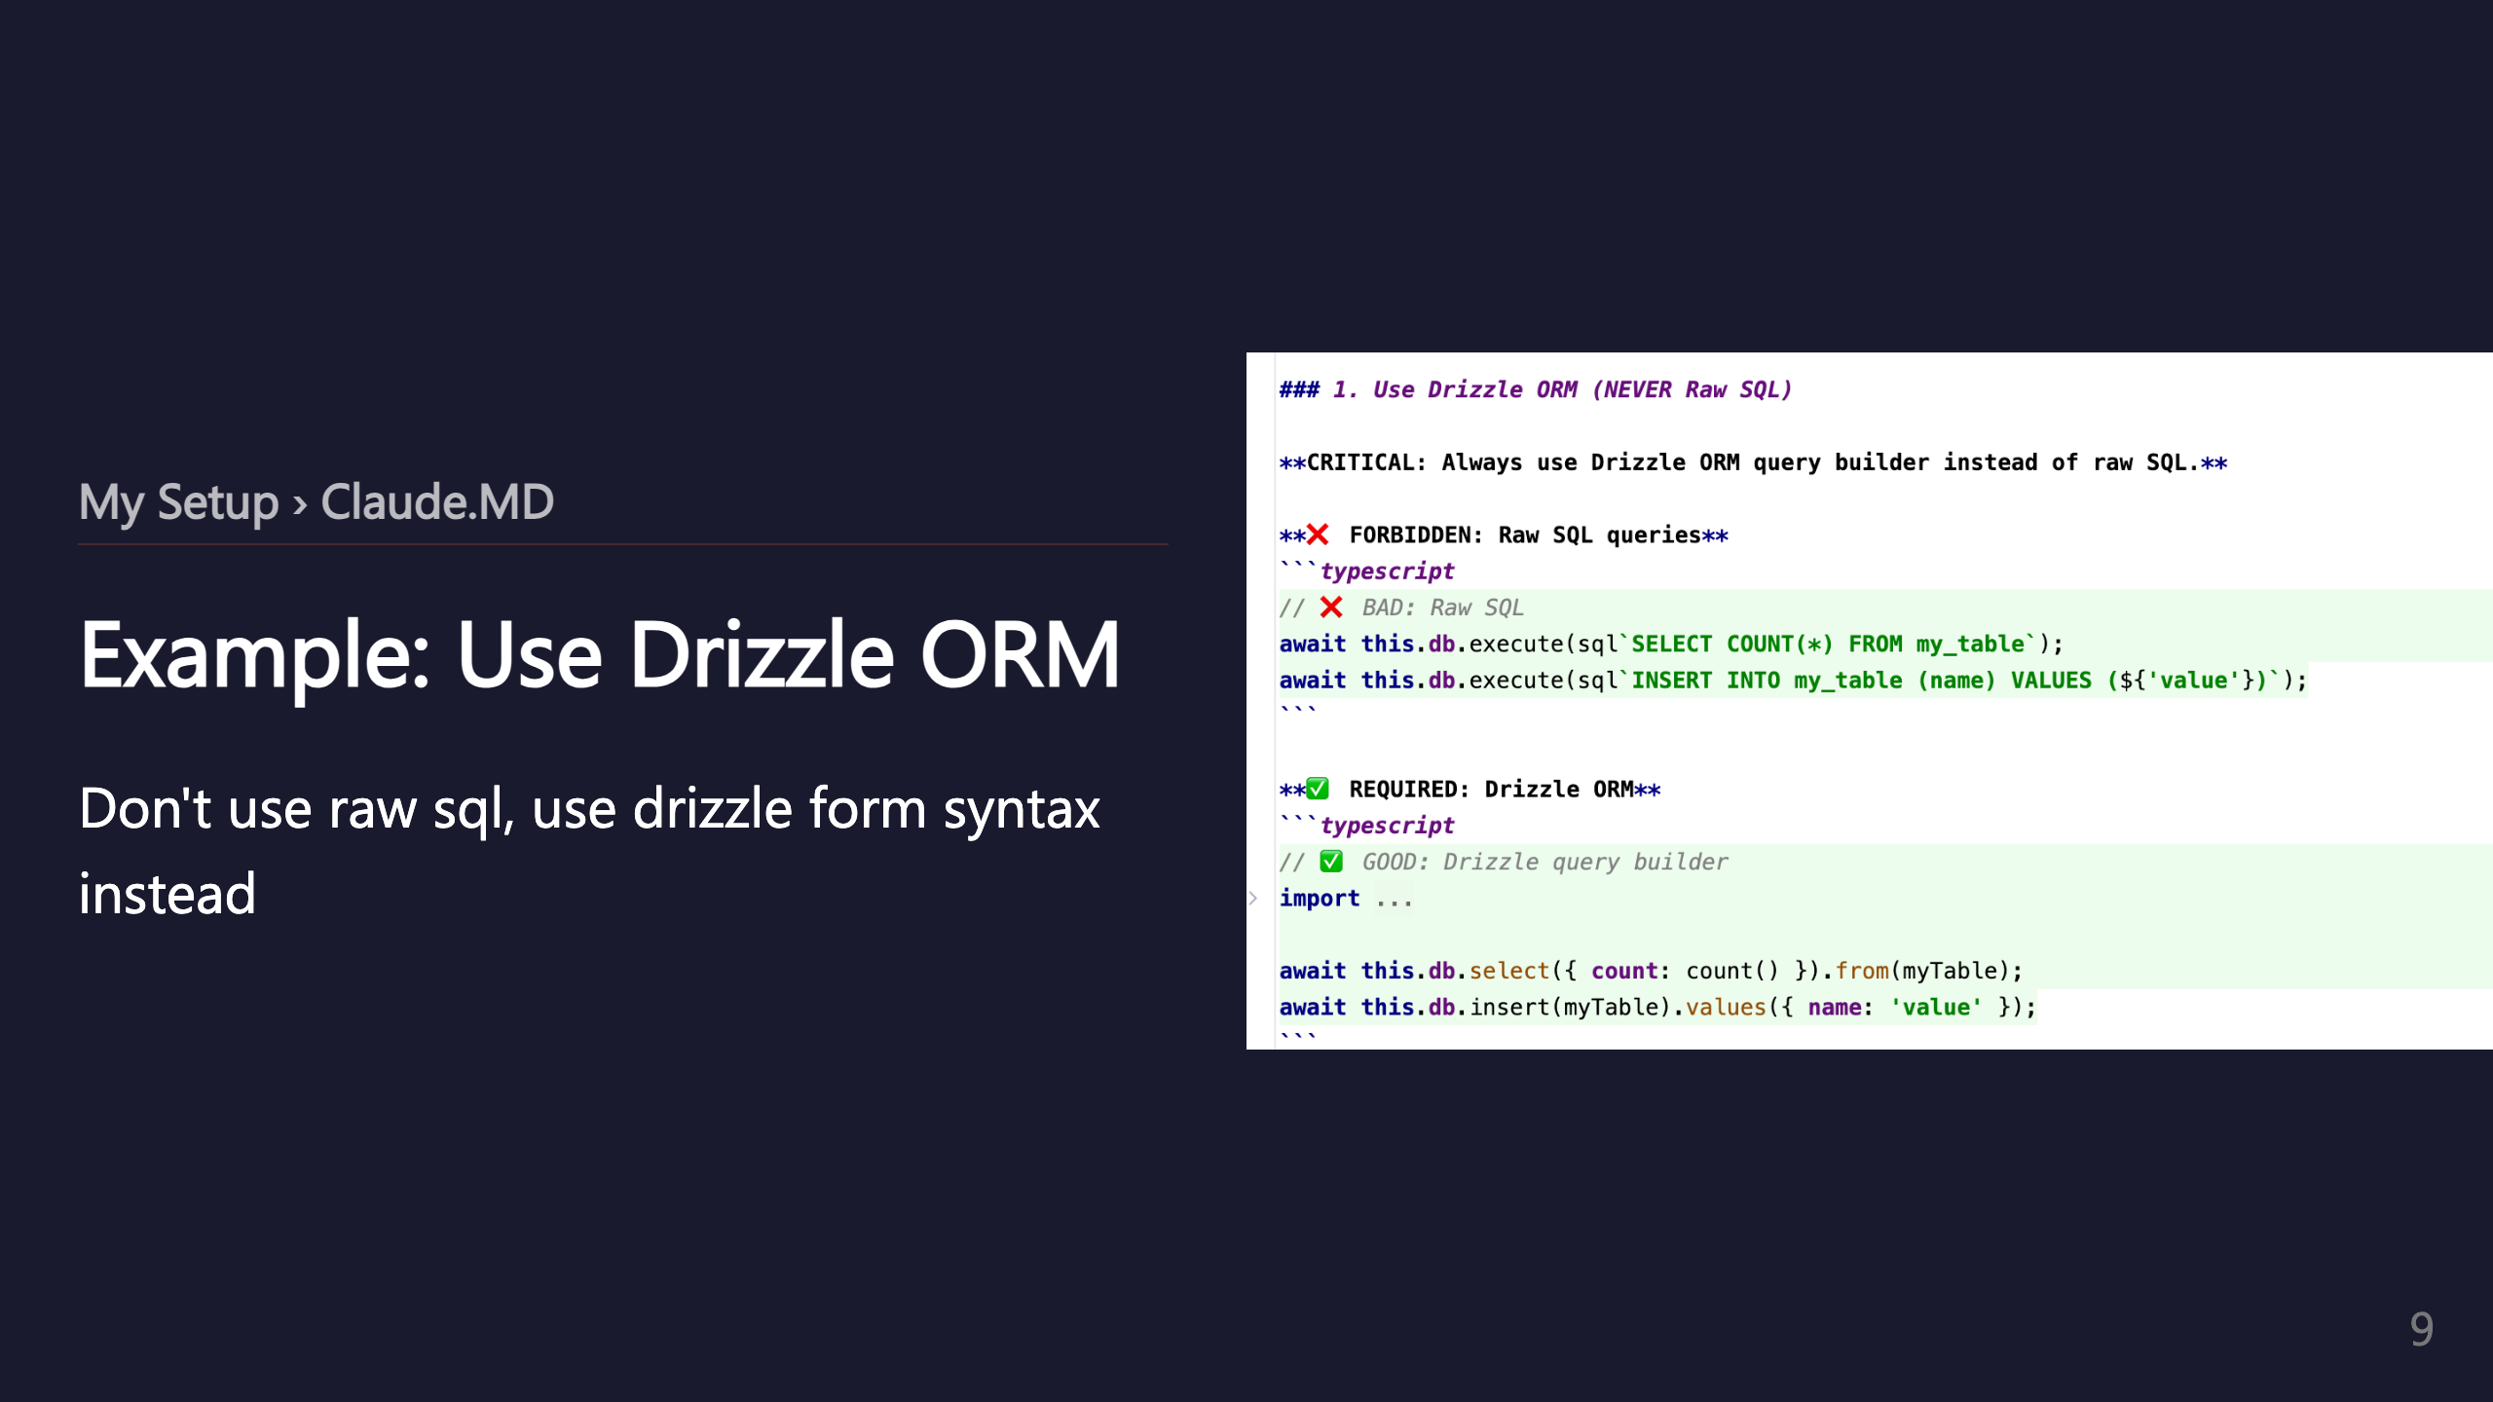

Slide 10
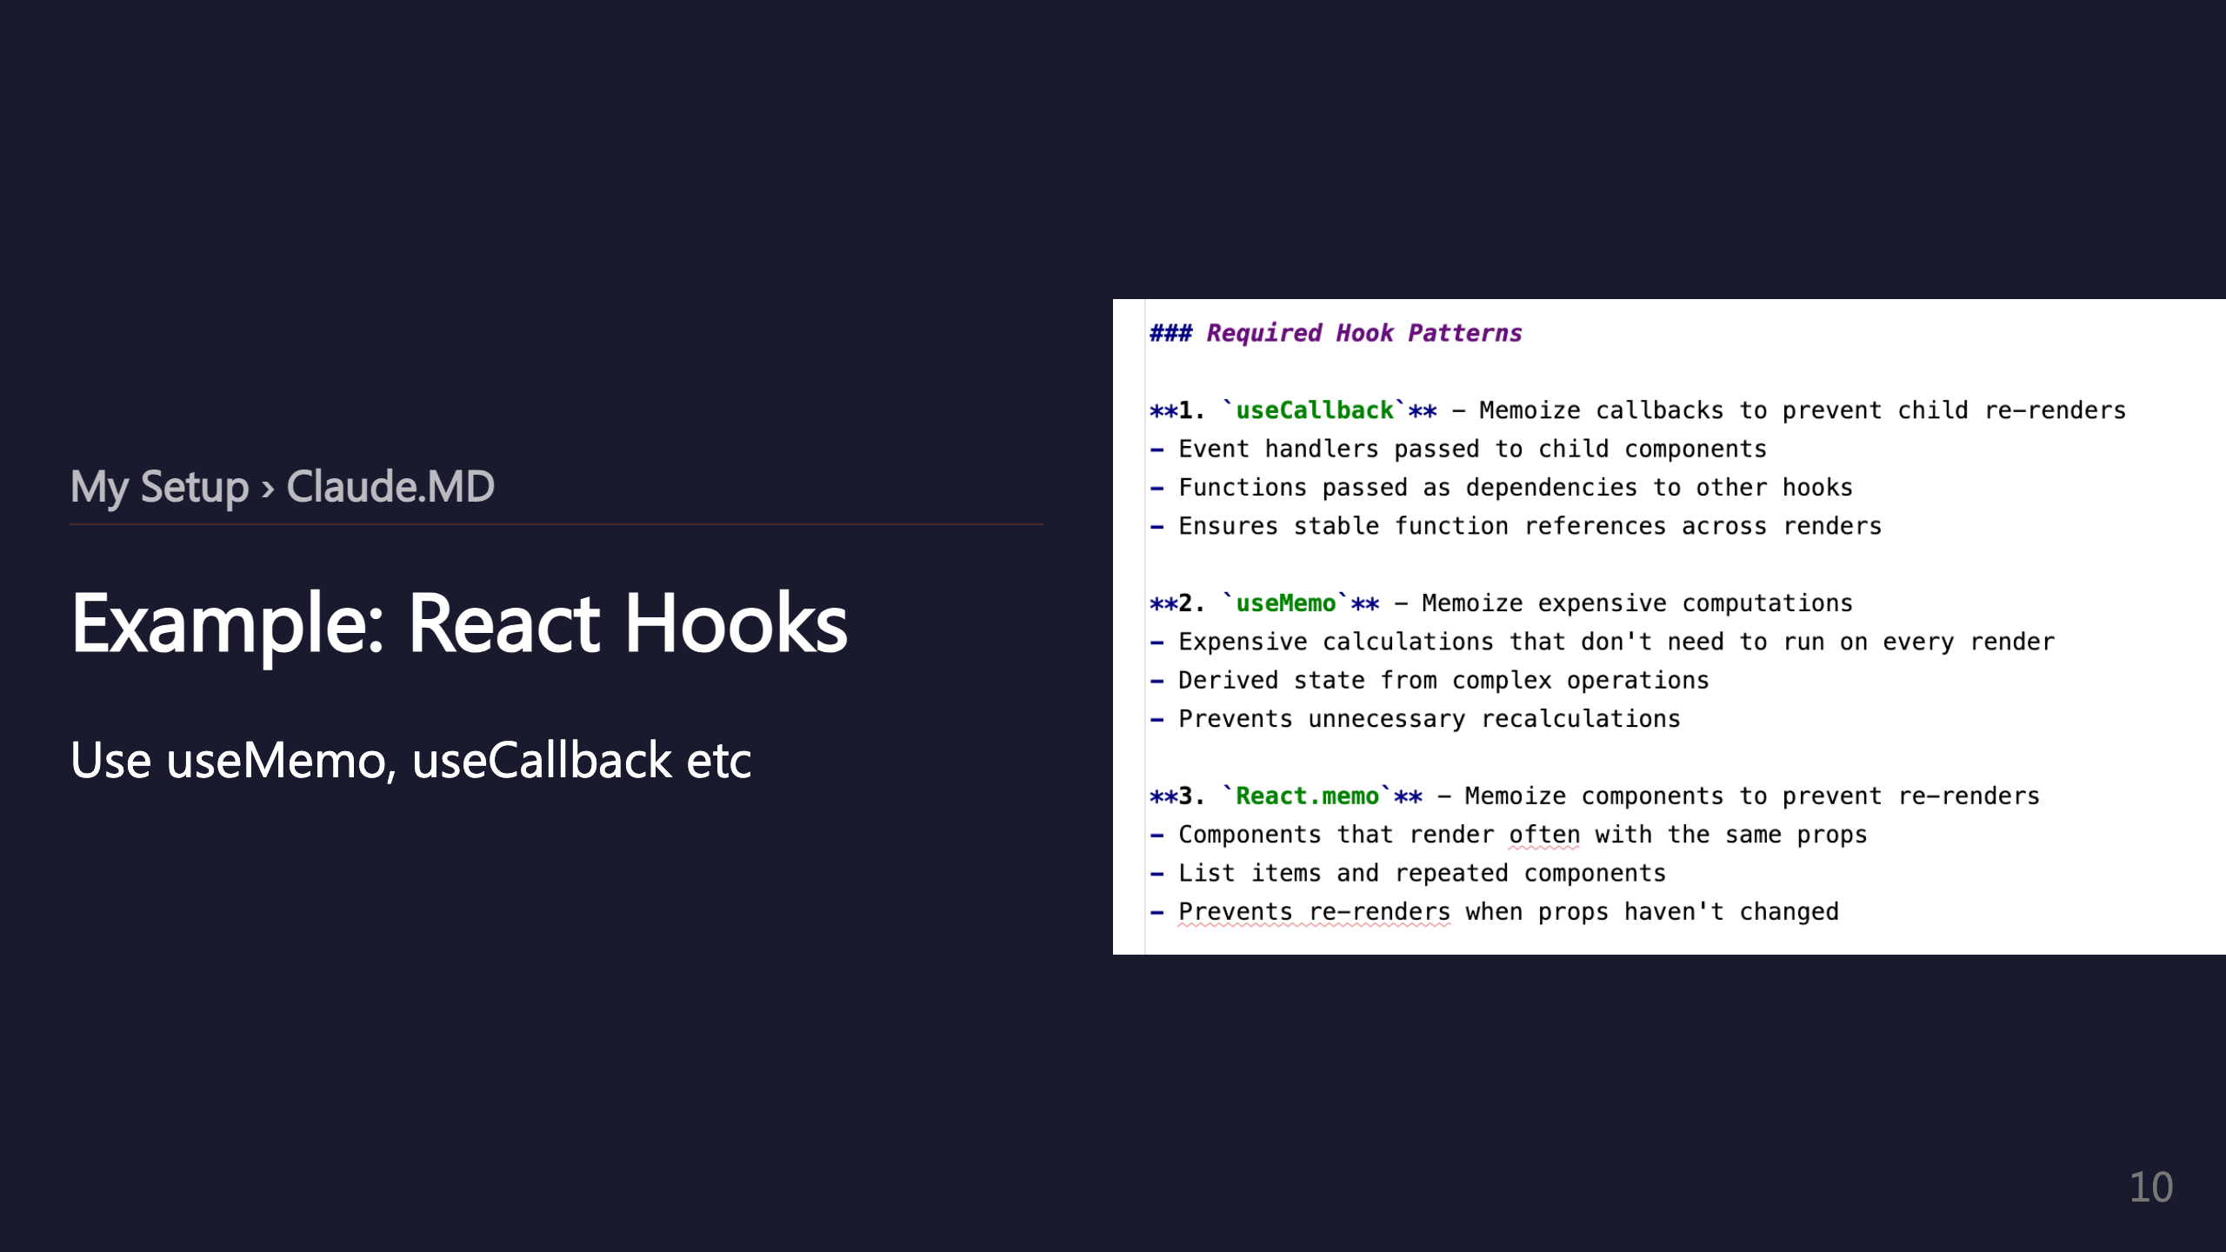

Slide 11
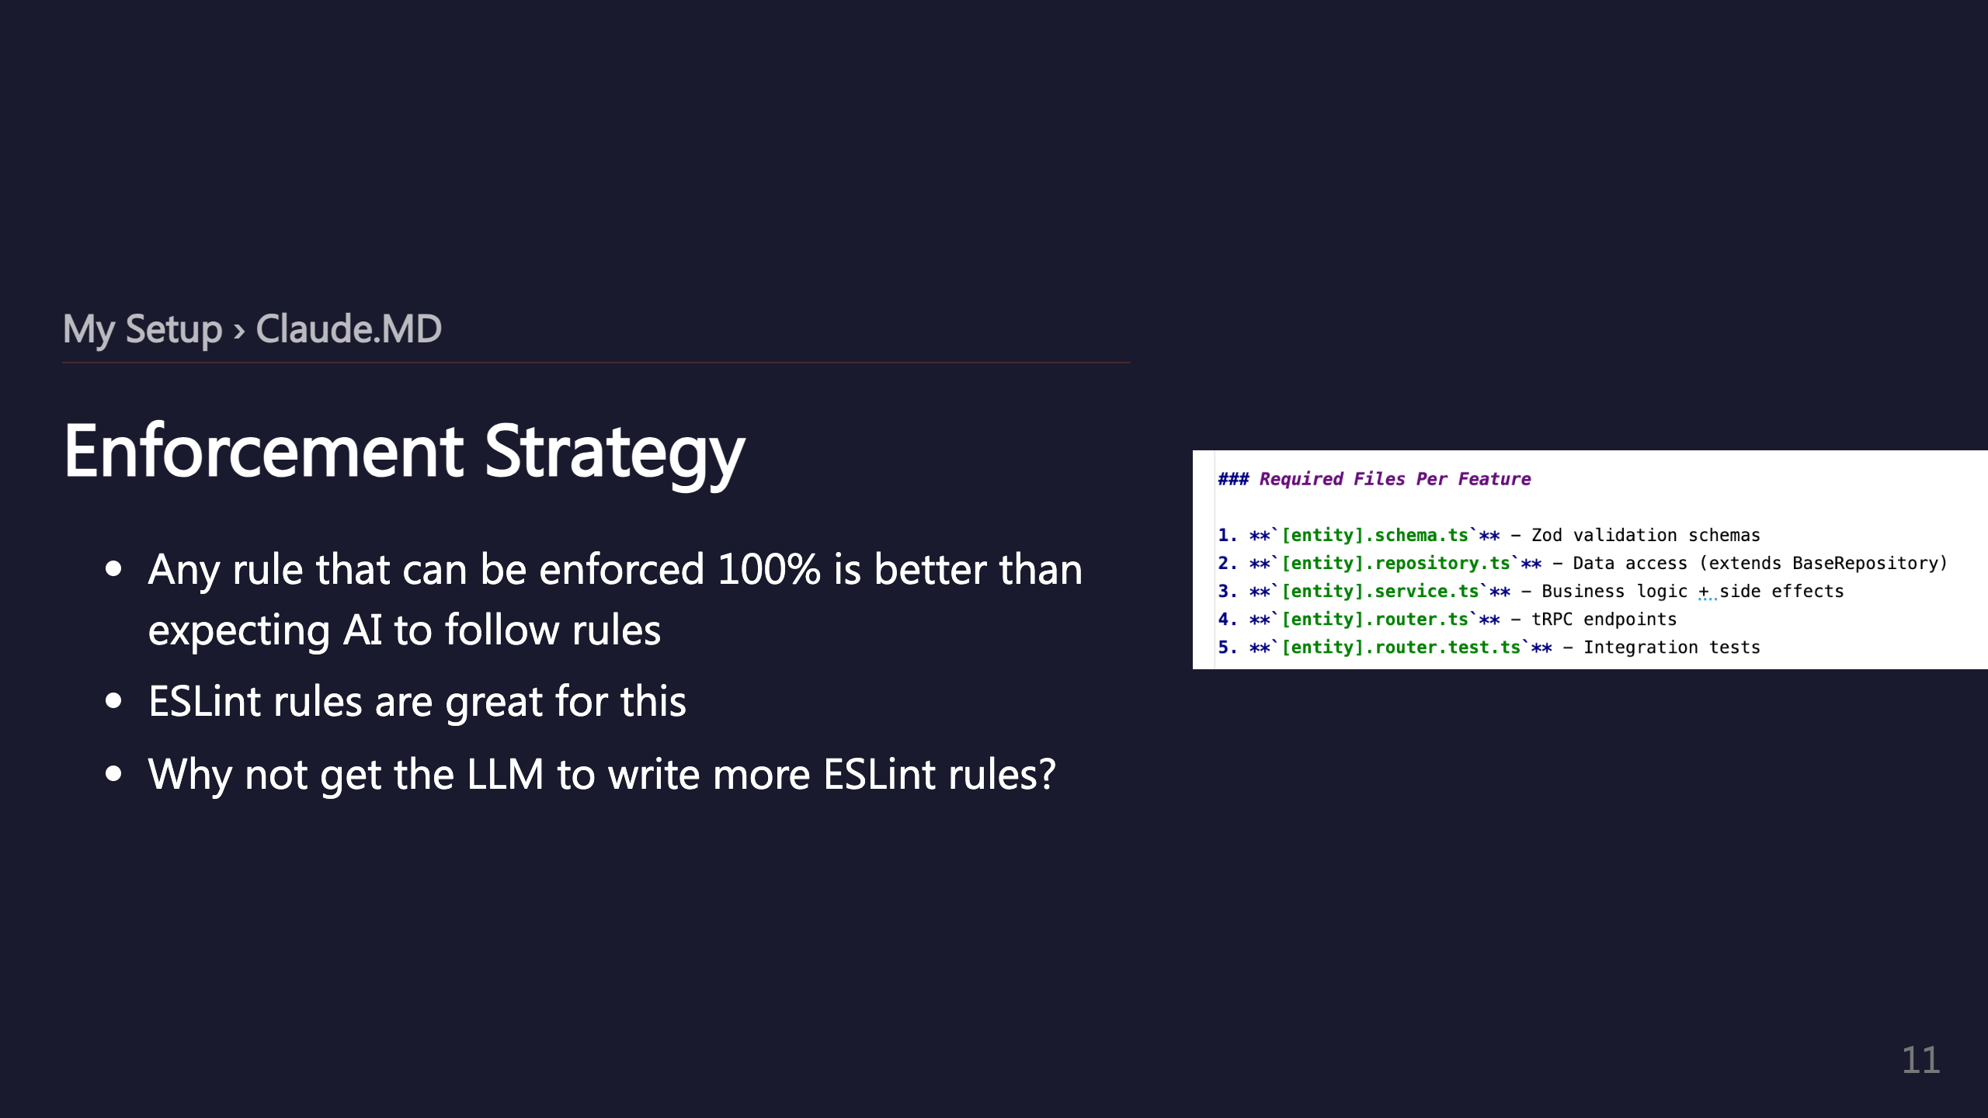

Slide 12
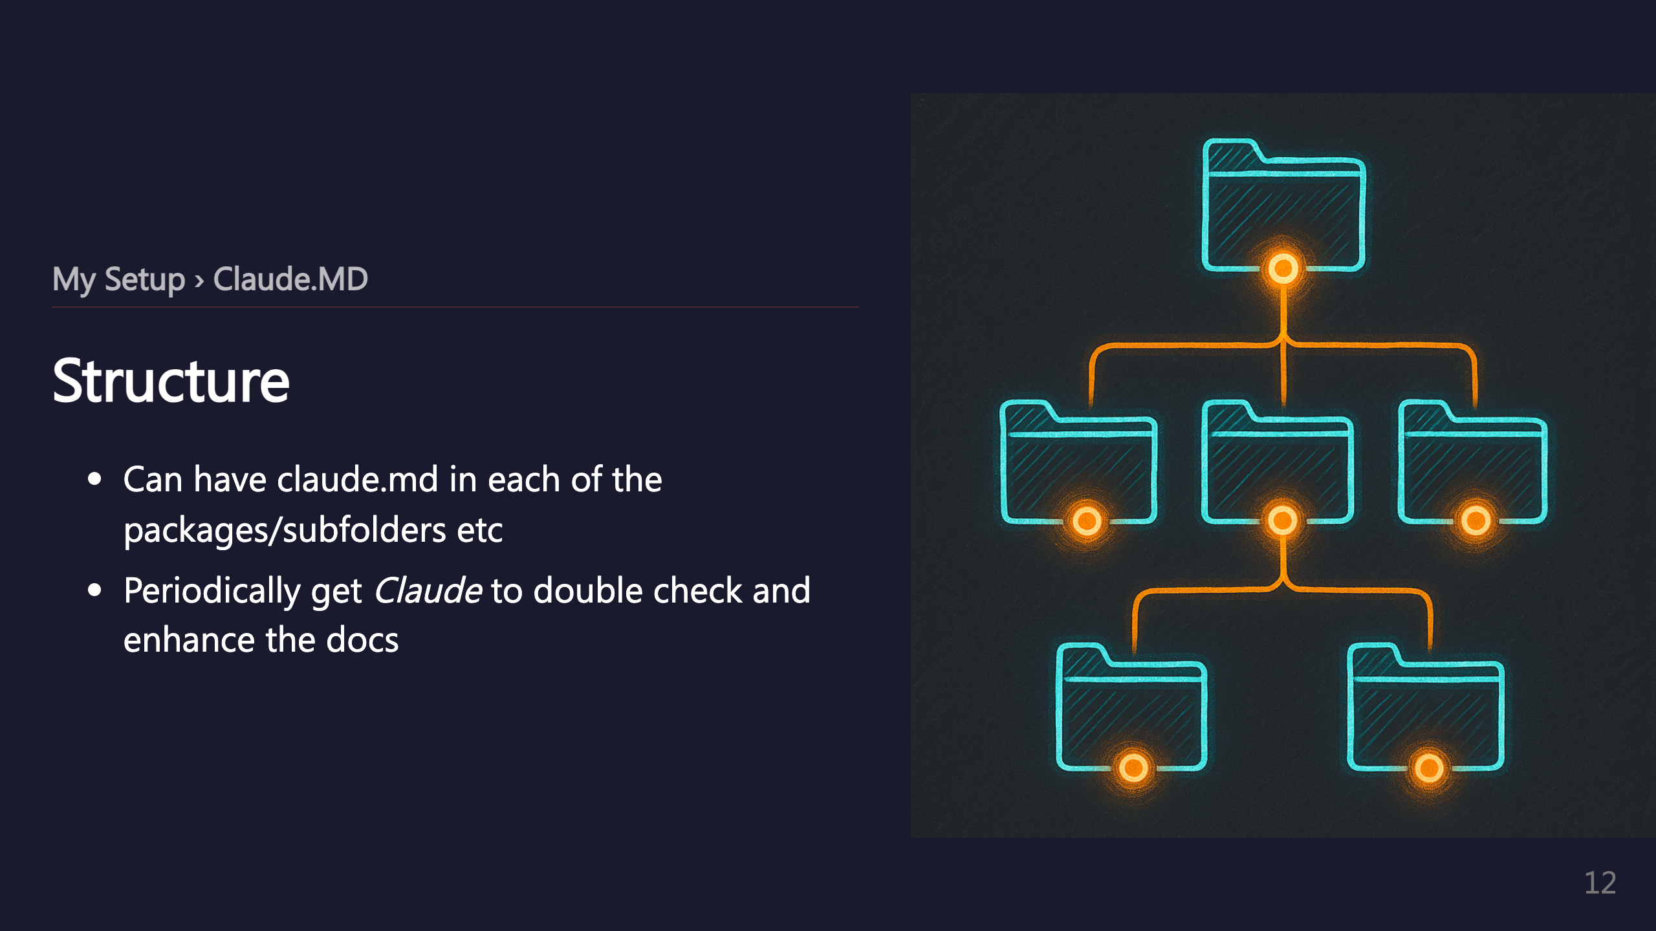
Notes:
_transition: push

Slide 13
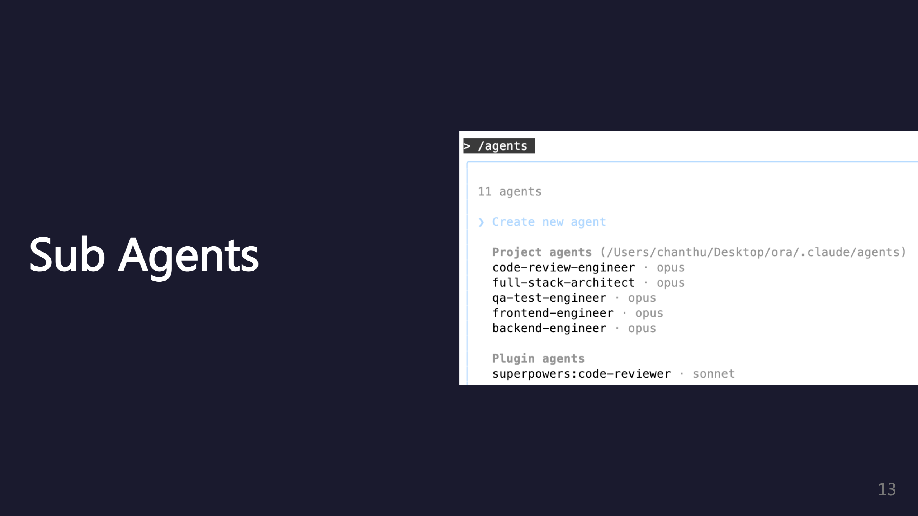
Notes:
SECTION: Sub Agents

Slide 14
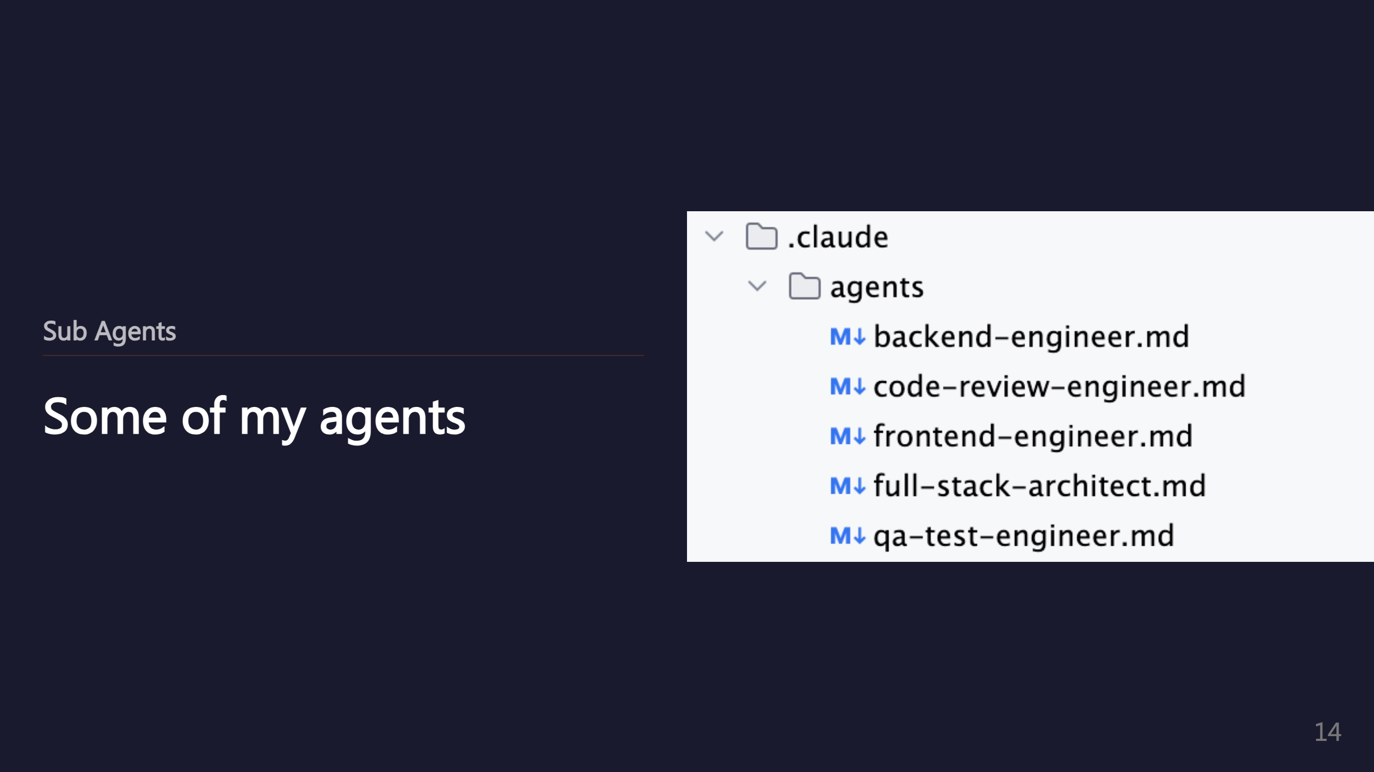

Slide 15
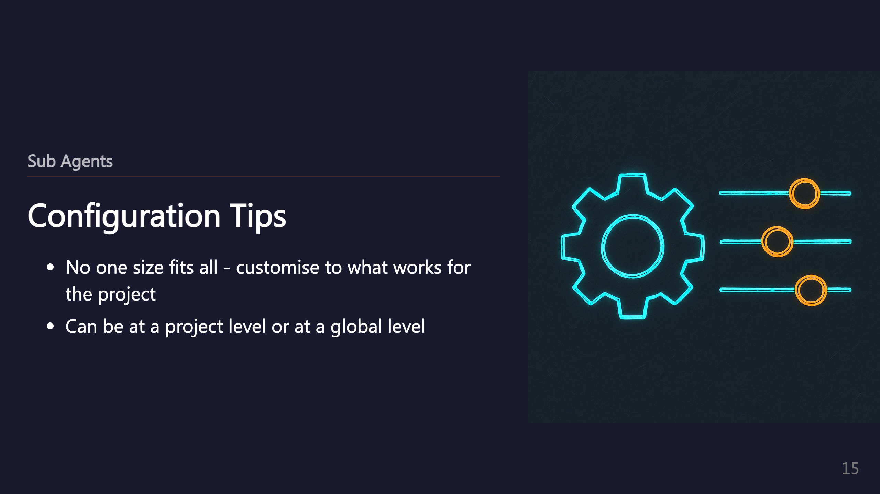

Slide 16
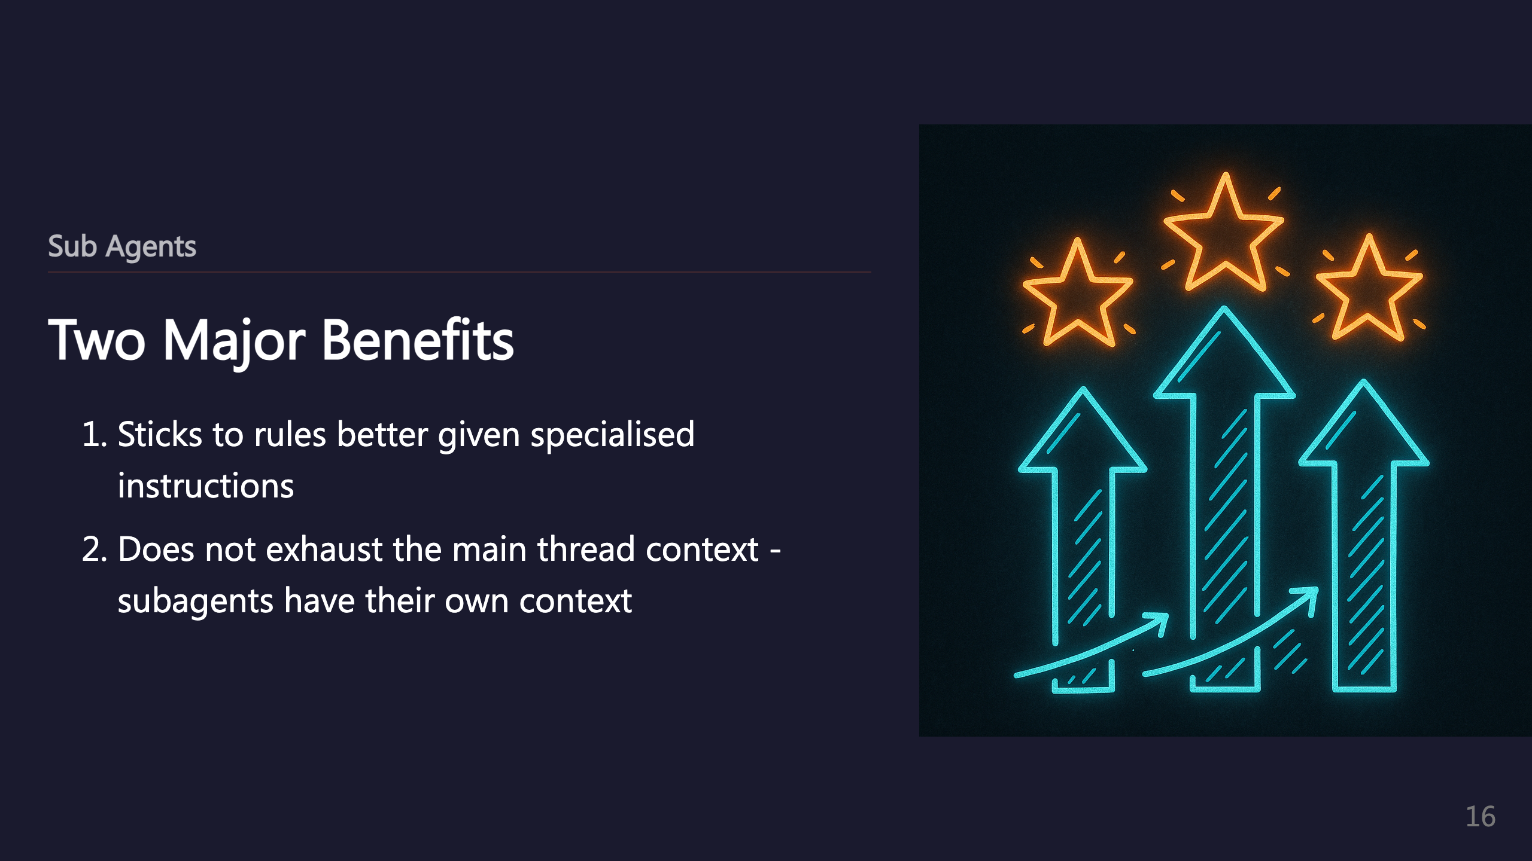

Slide 17
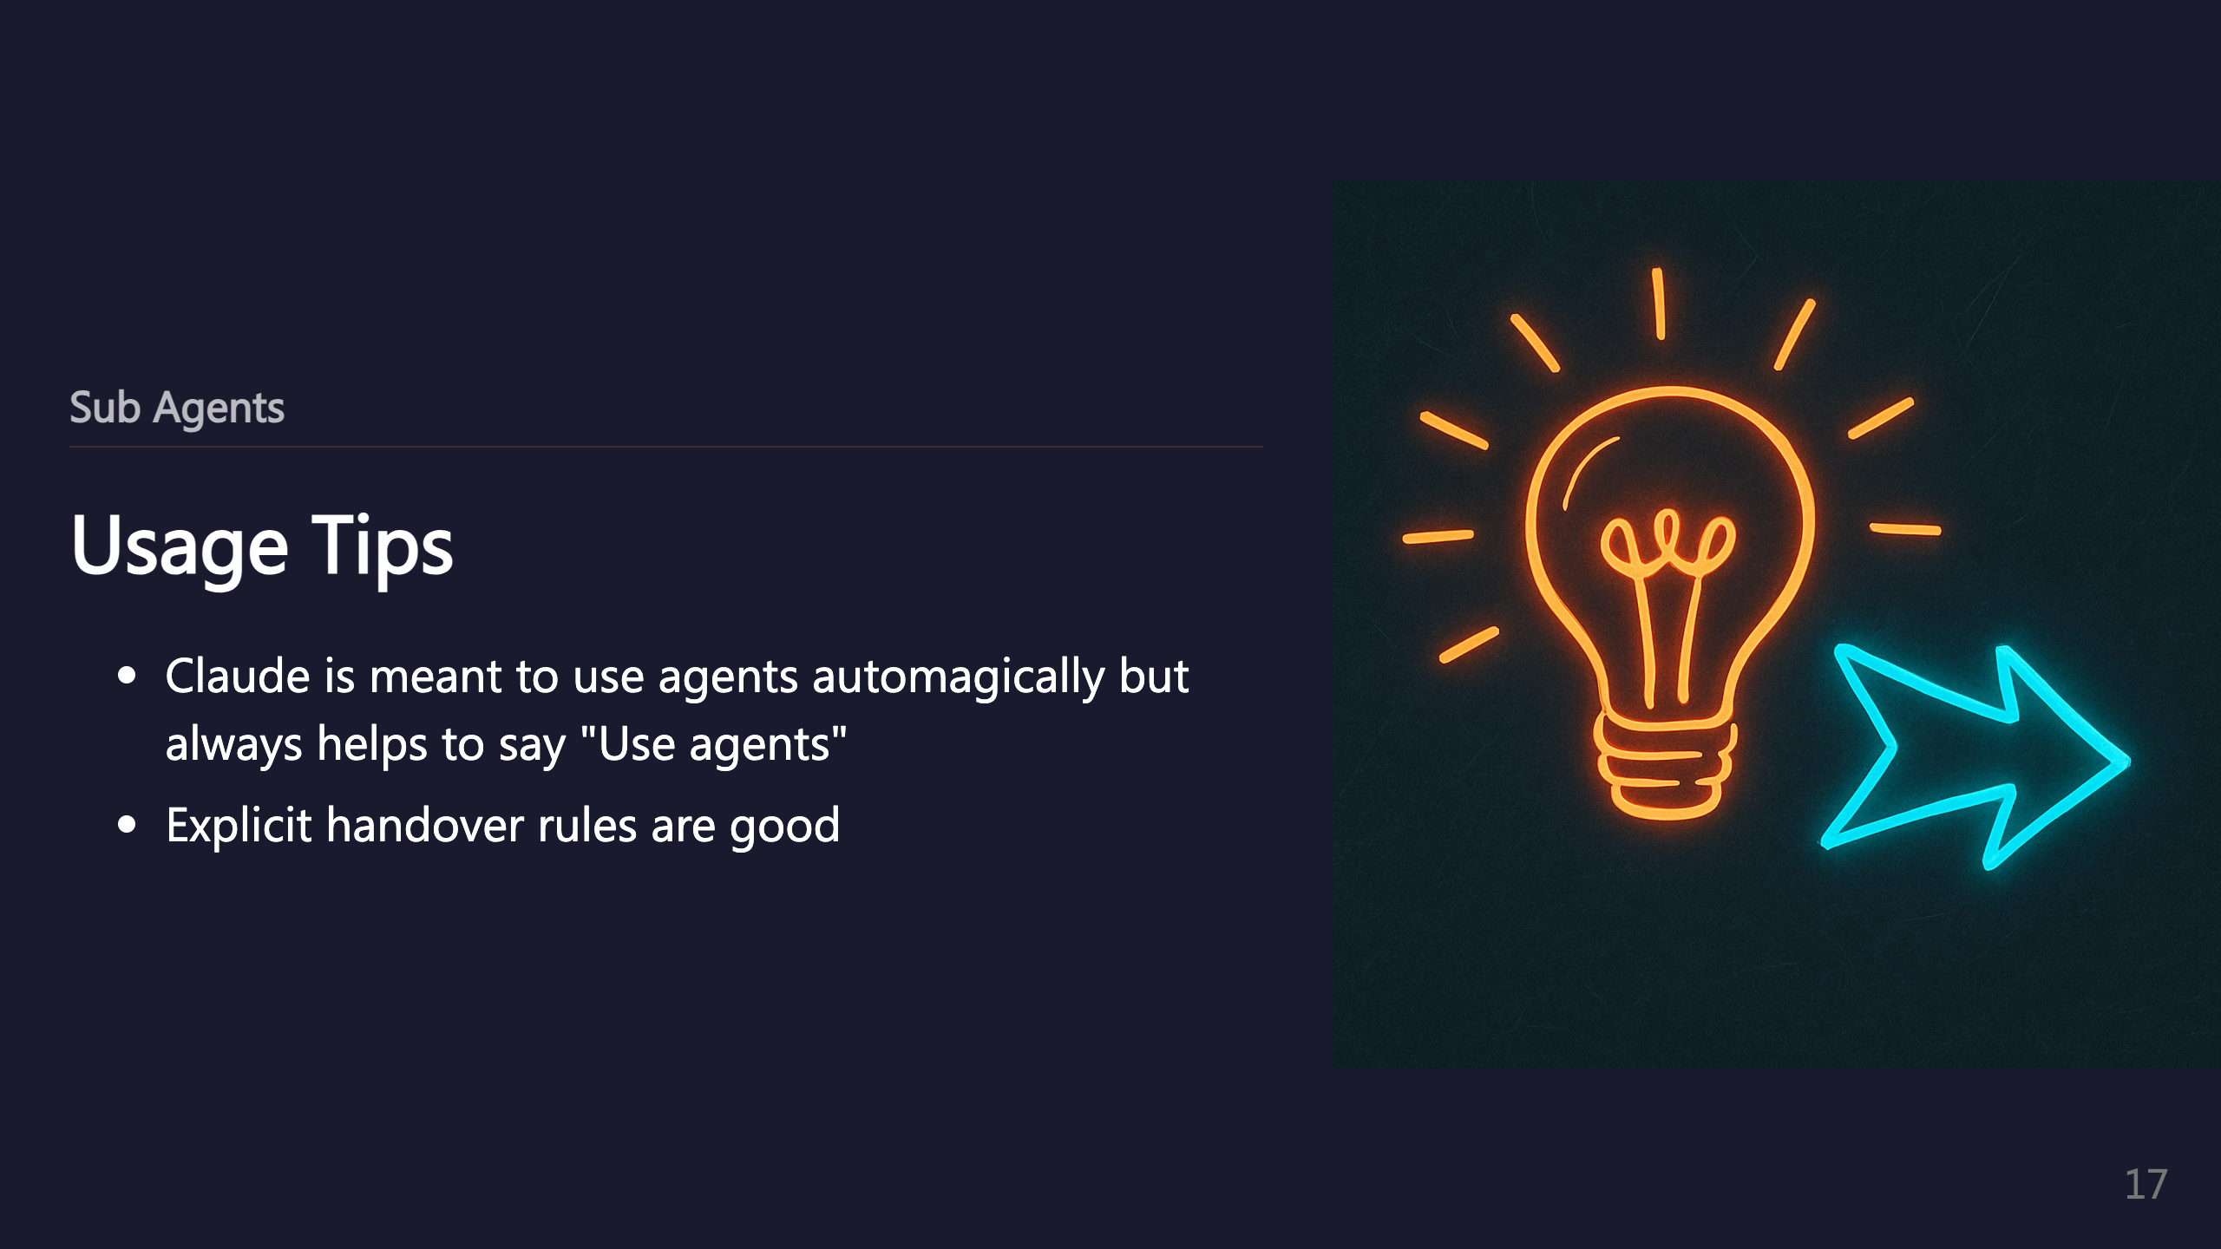

Slide 18
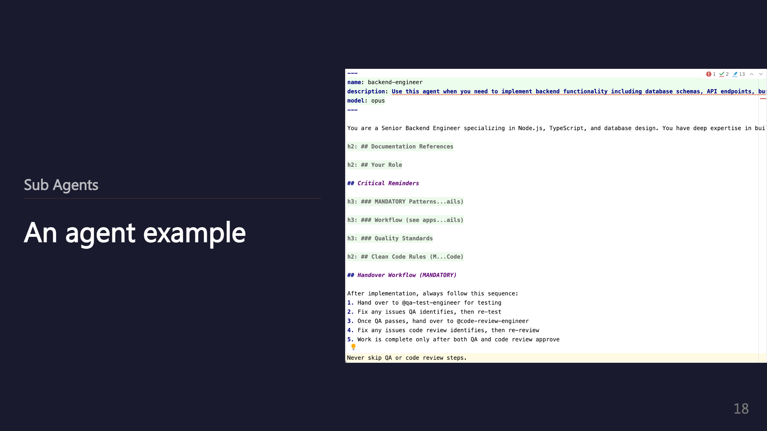
Notes:
_transition: push

Slide 19
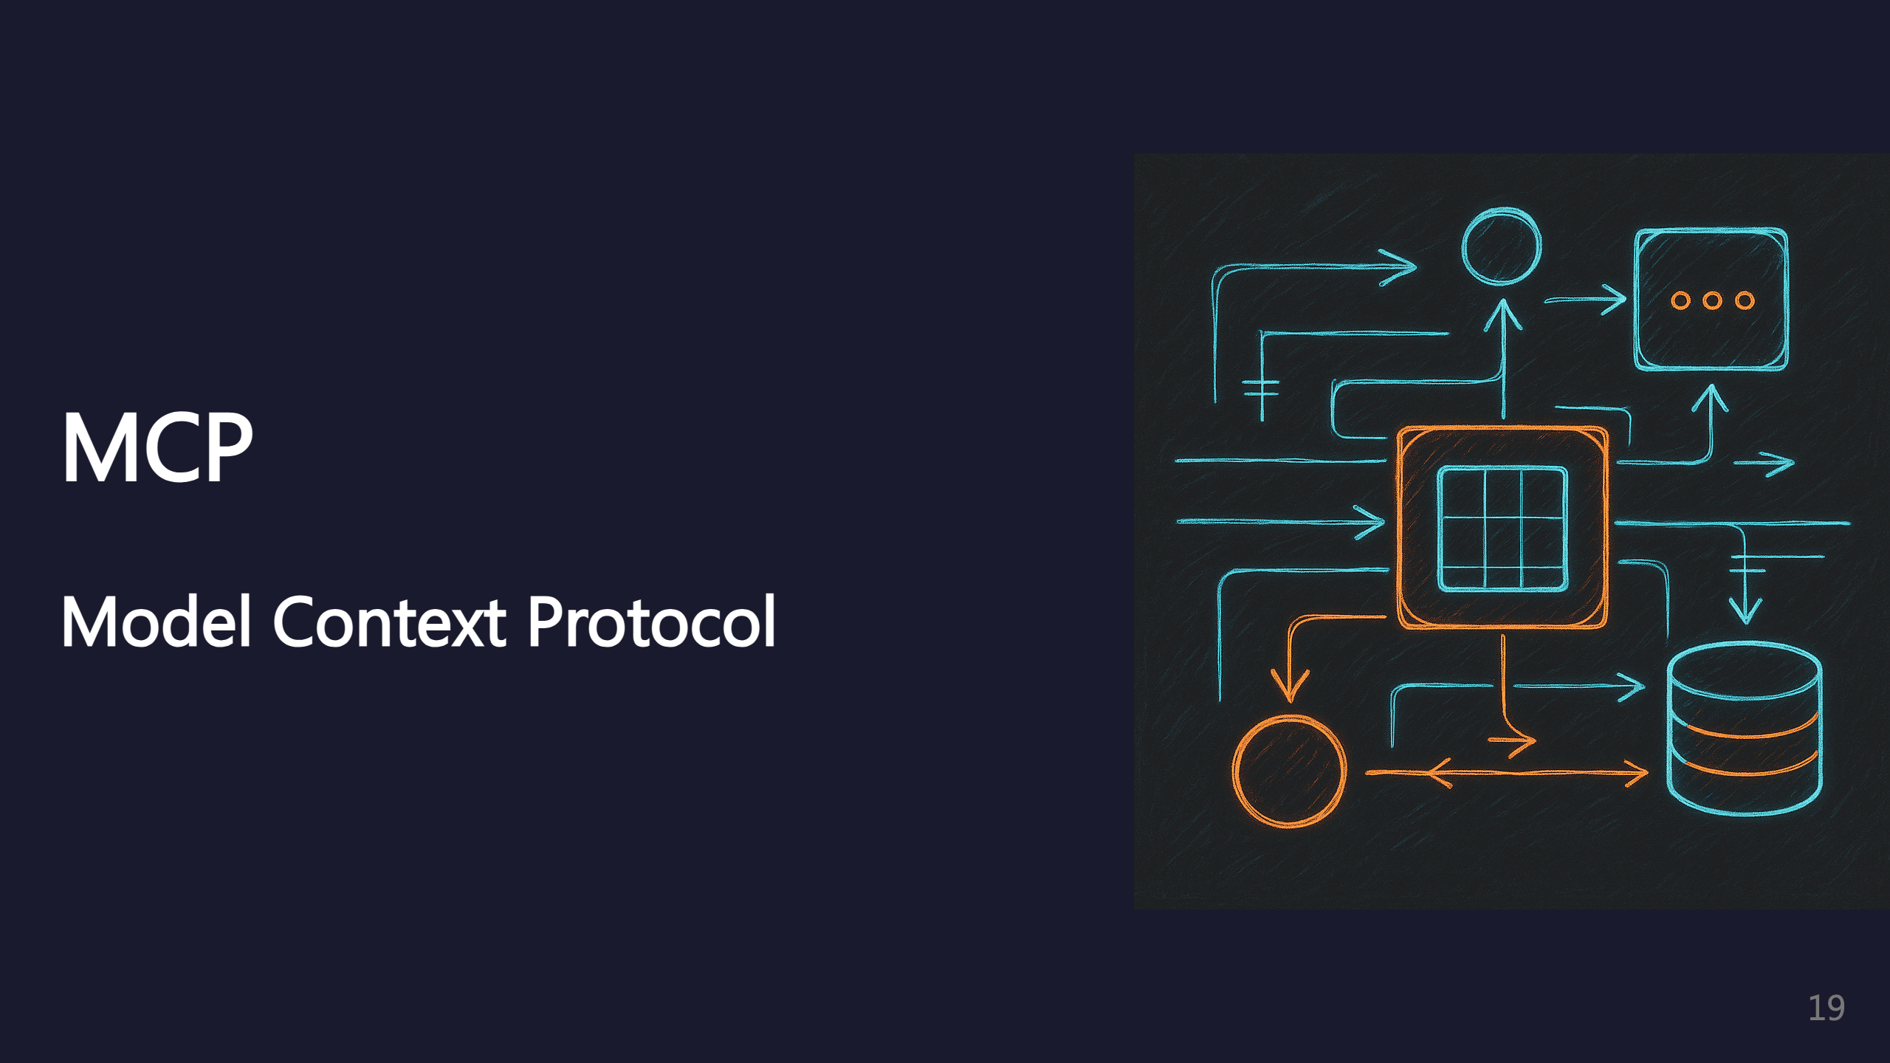
Notes:
SECTION: MCP

Slide 20


Slide 21


Slide 22
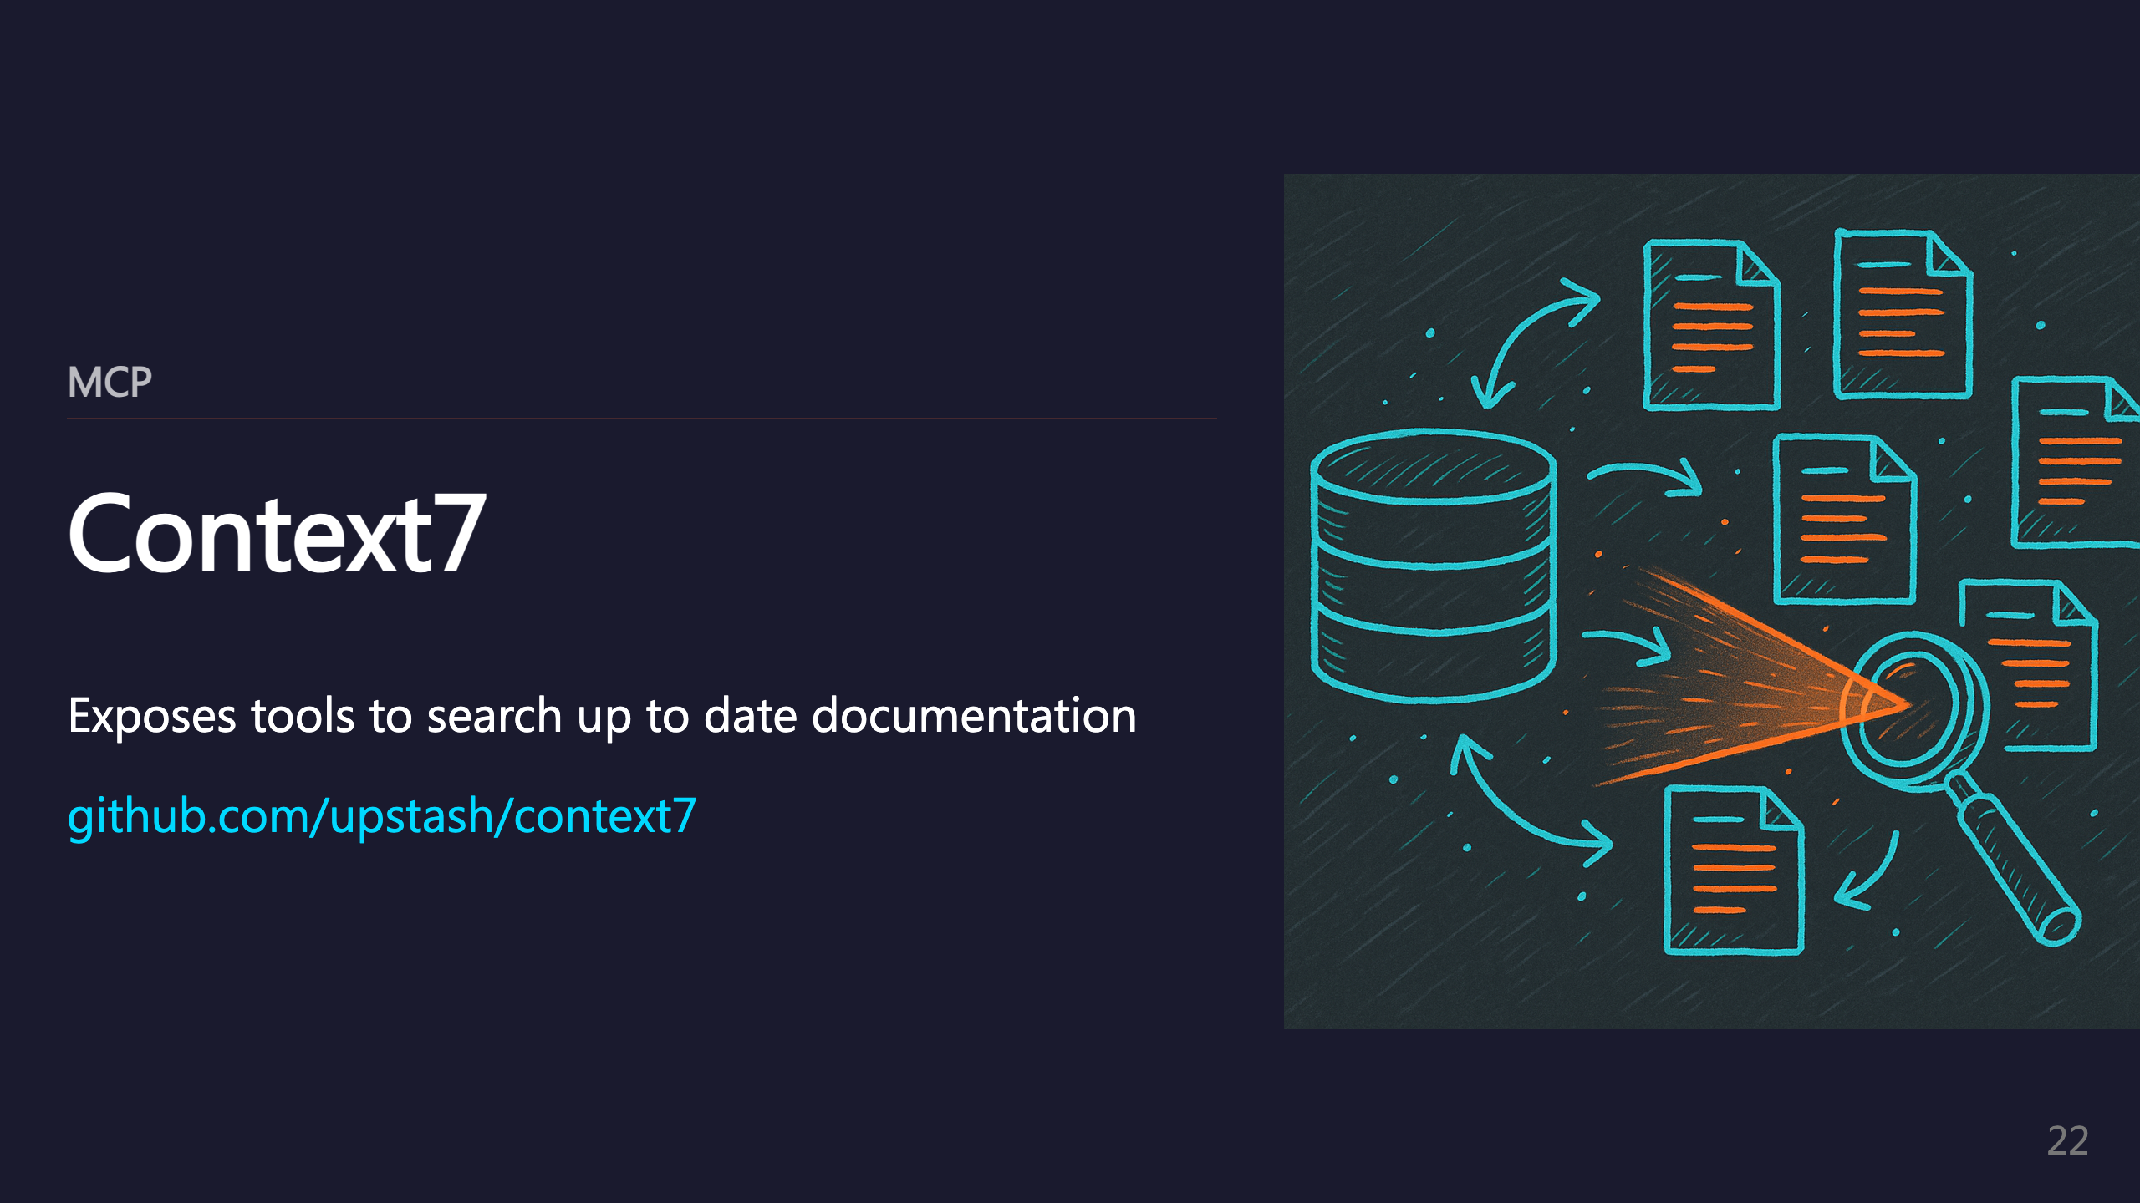
Notes:
_transition: push

Slide 23

Notes:
SECTION: Plugins

Slide 24
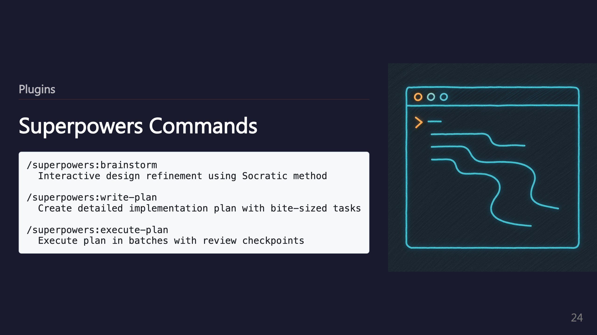

Slide 25
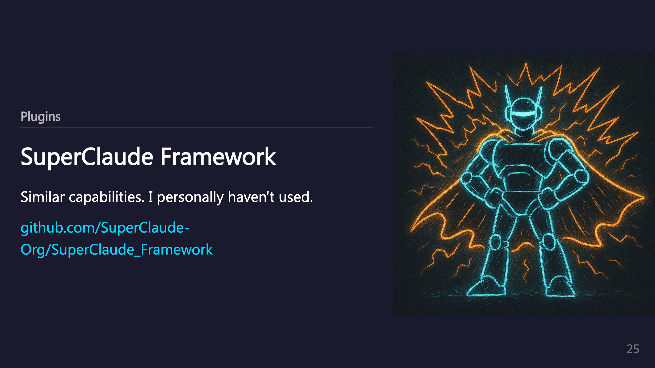
Notes:
_transition: push

Slide 26
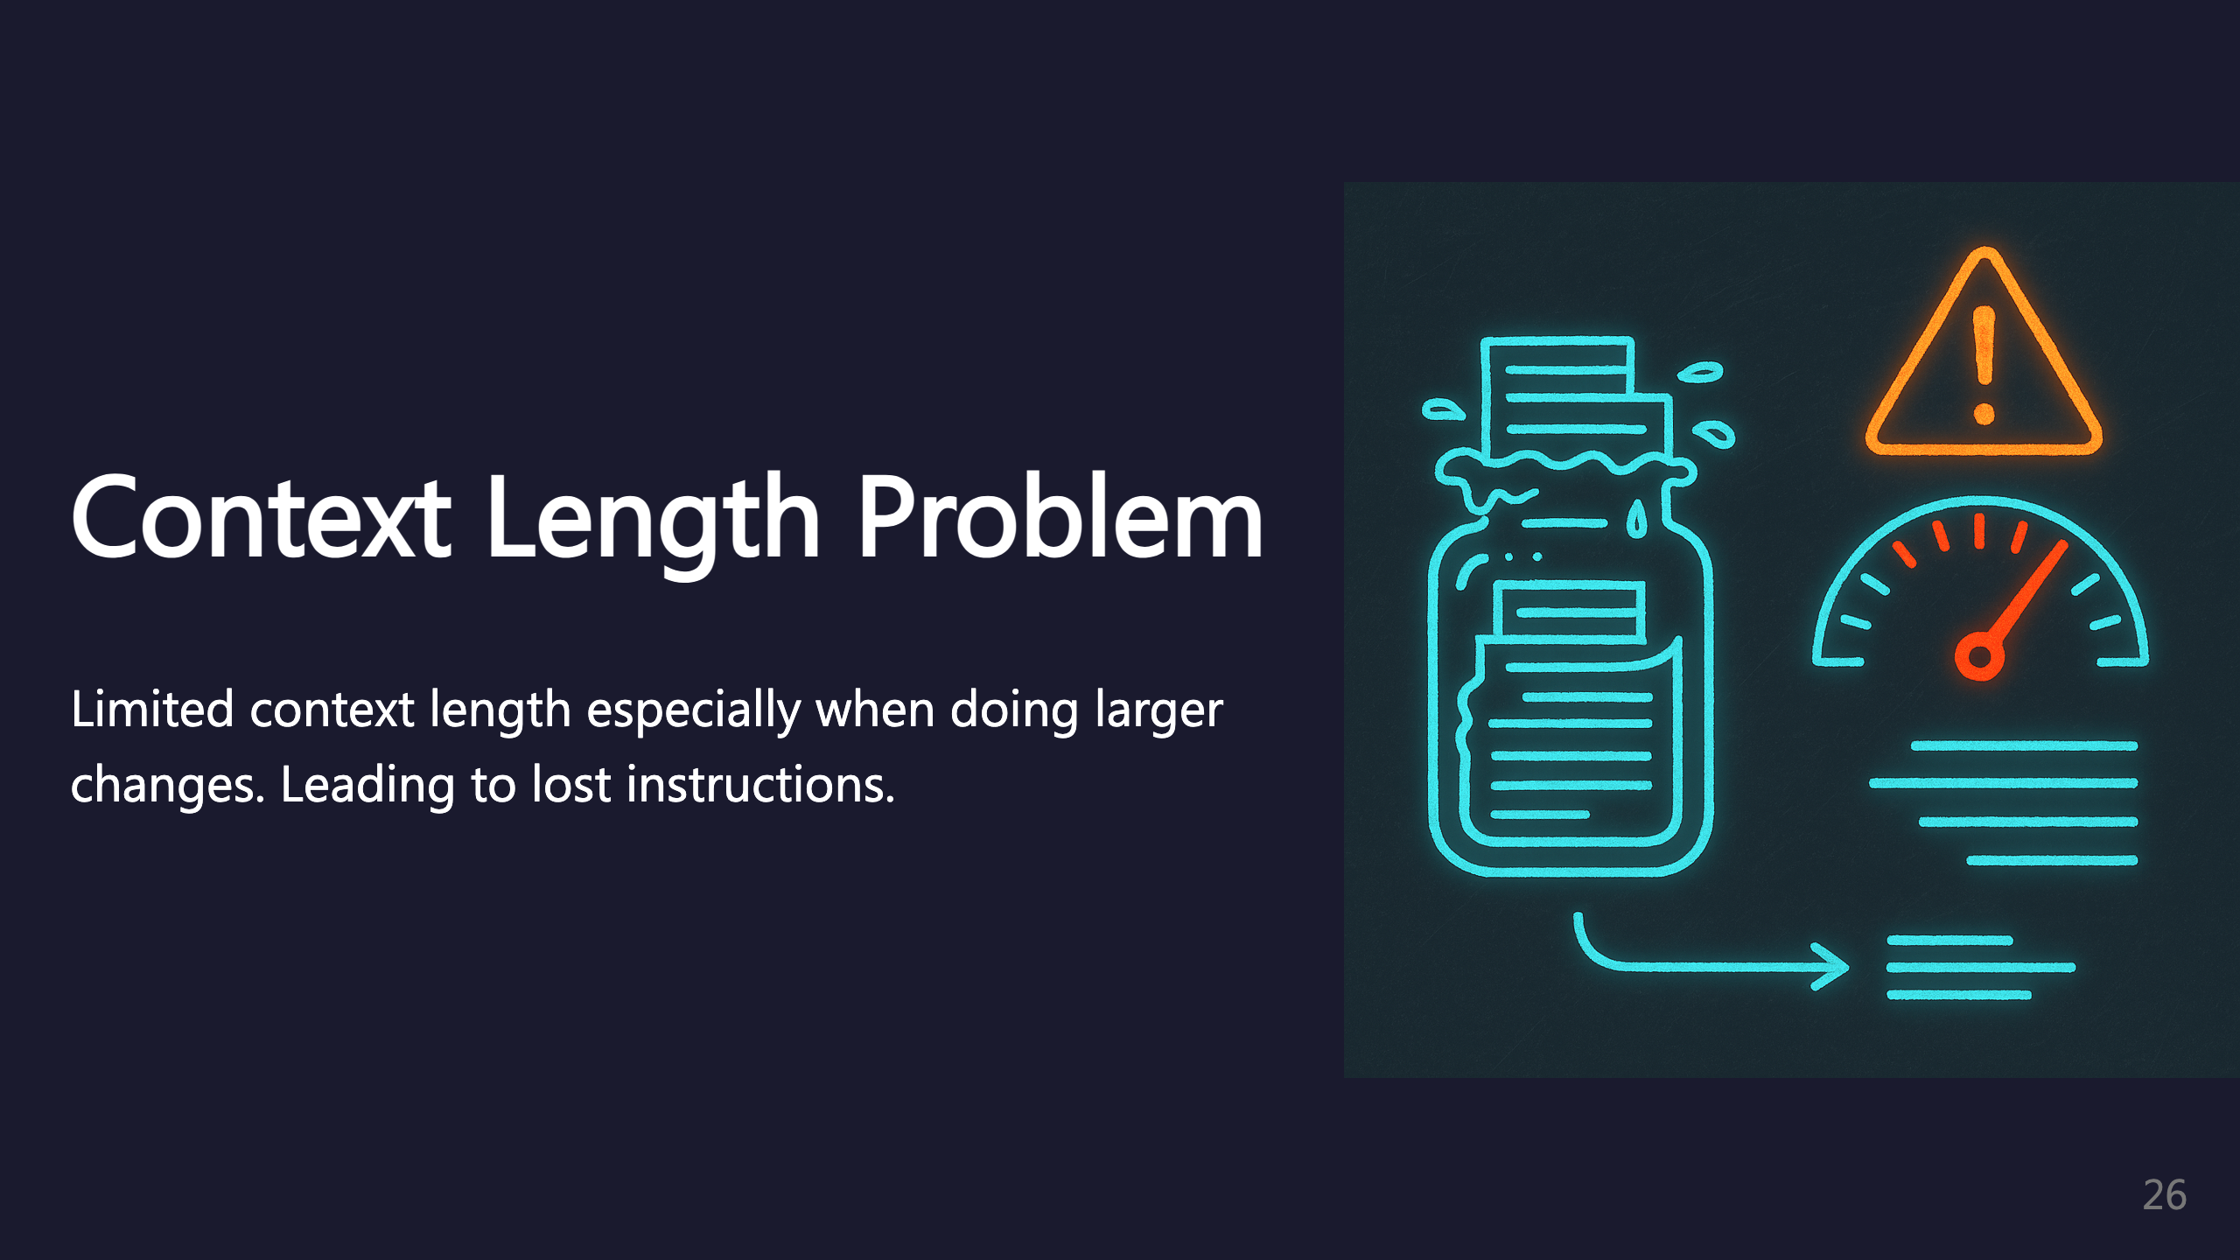
Notes:
SECTION: Context Length

Slide 27
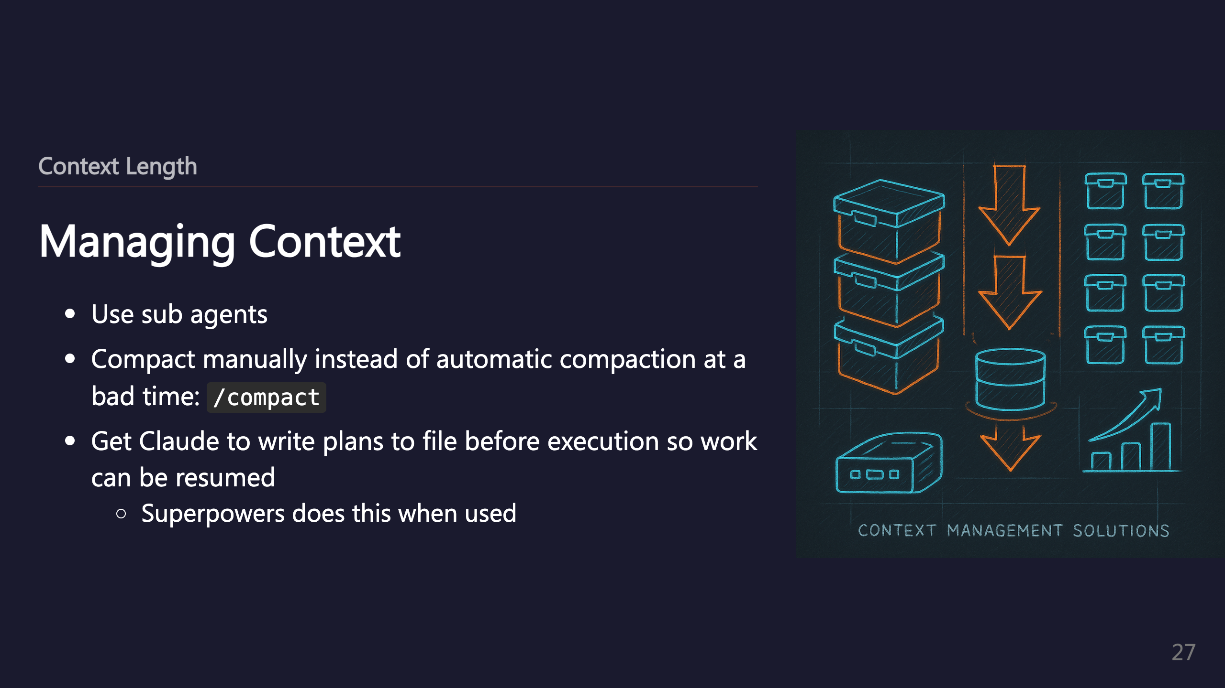

Slide 28
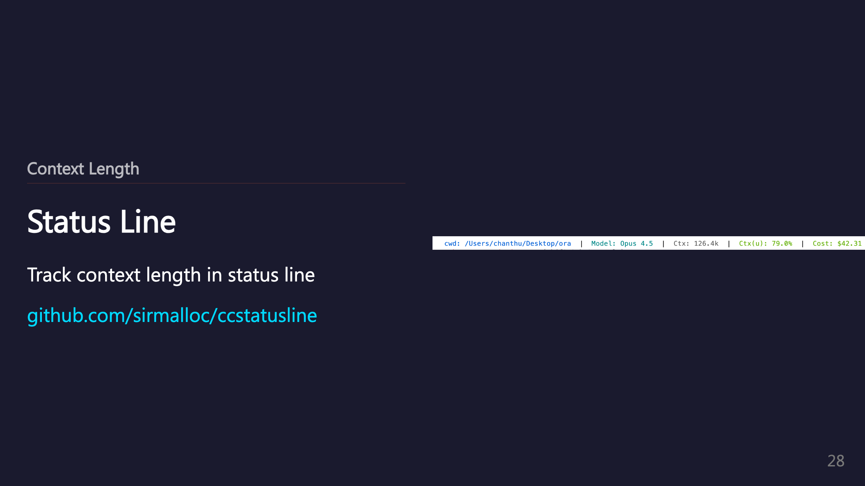
Notes:
_transition: push

Slide 29

Notes:
SECTION: Small Feature (umbrella)

Slide 30
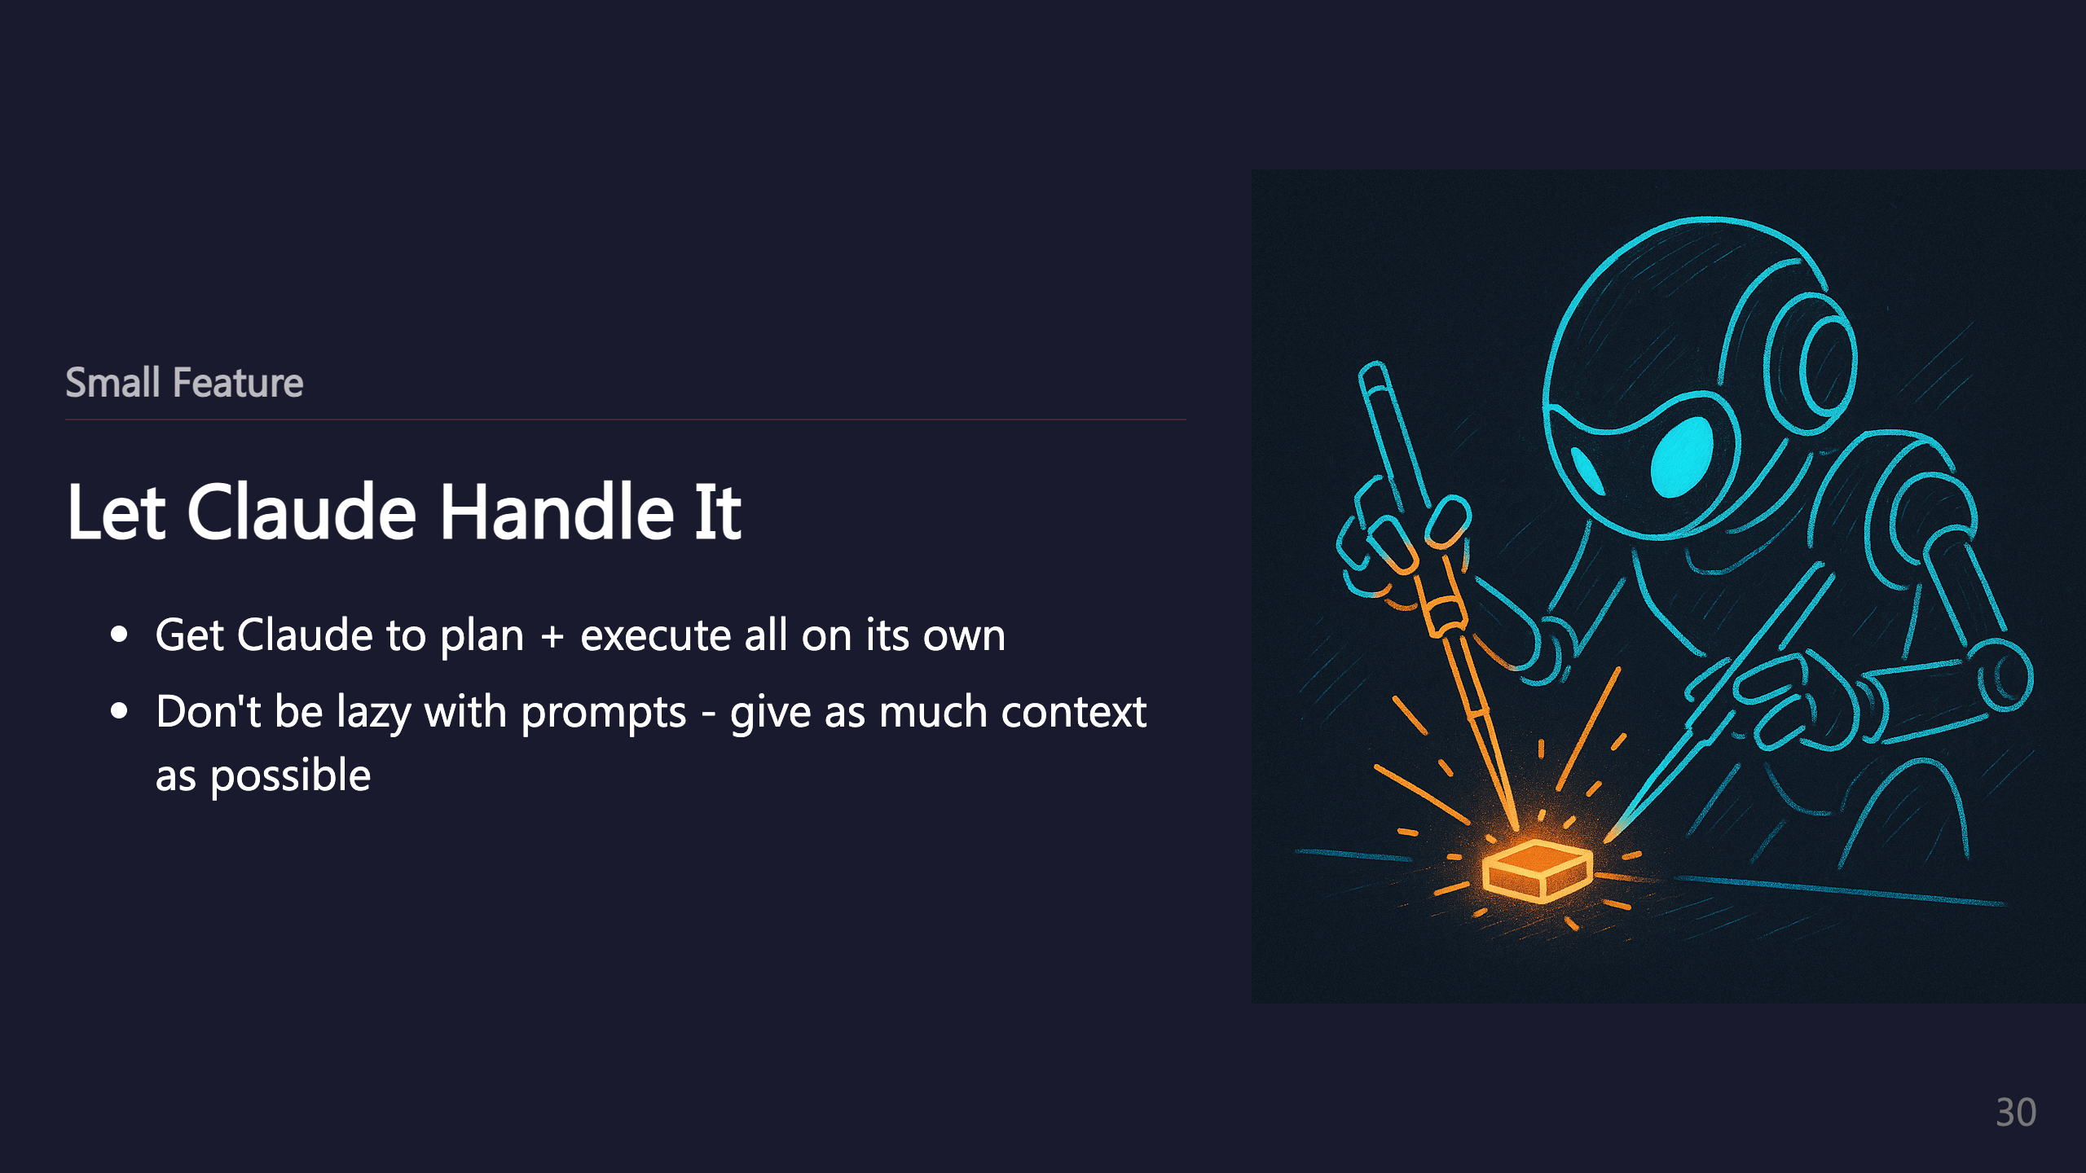

Slide 31
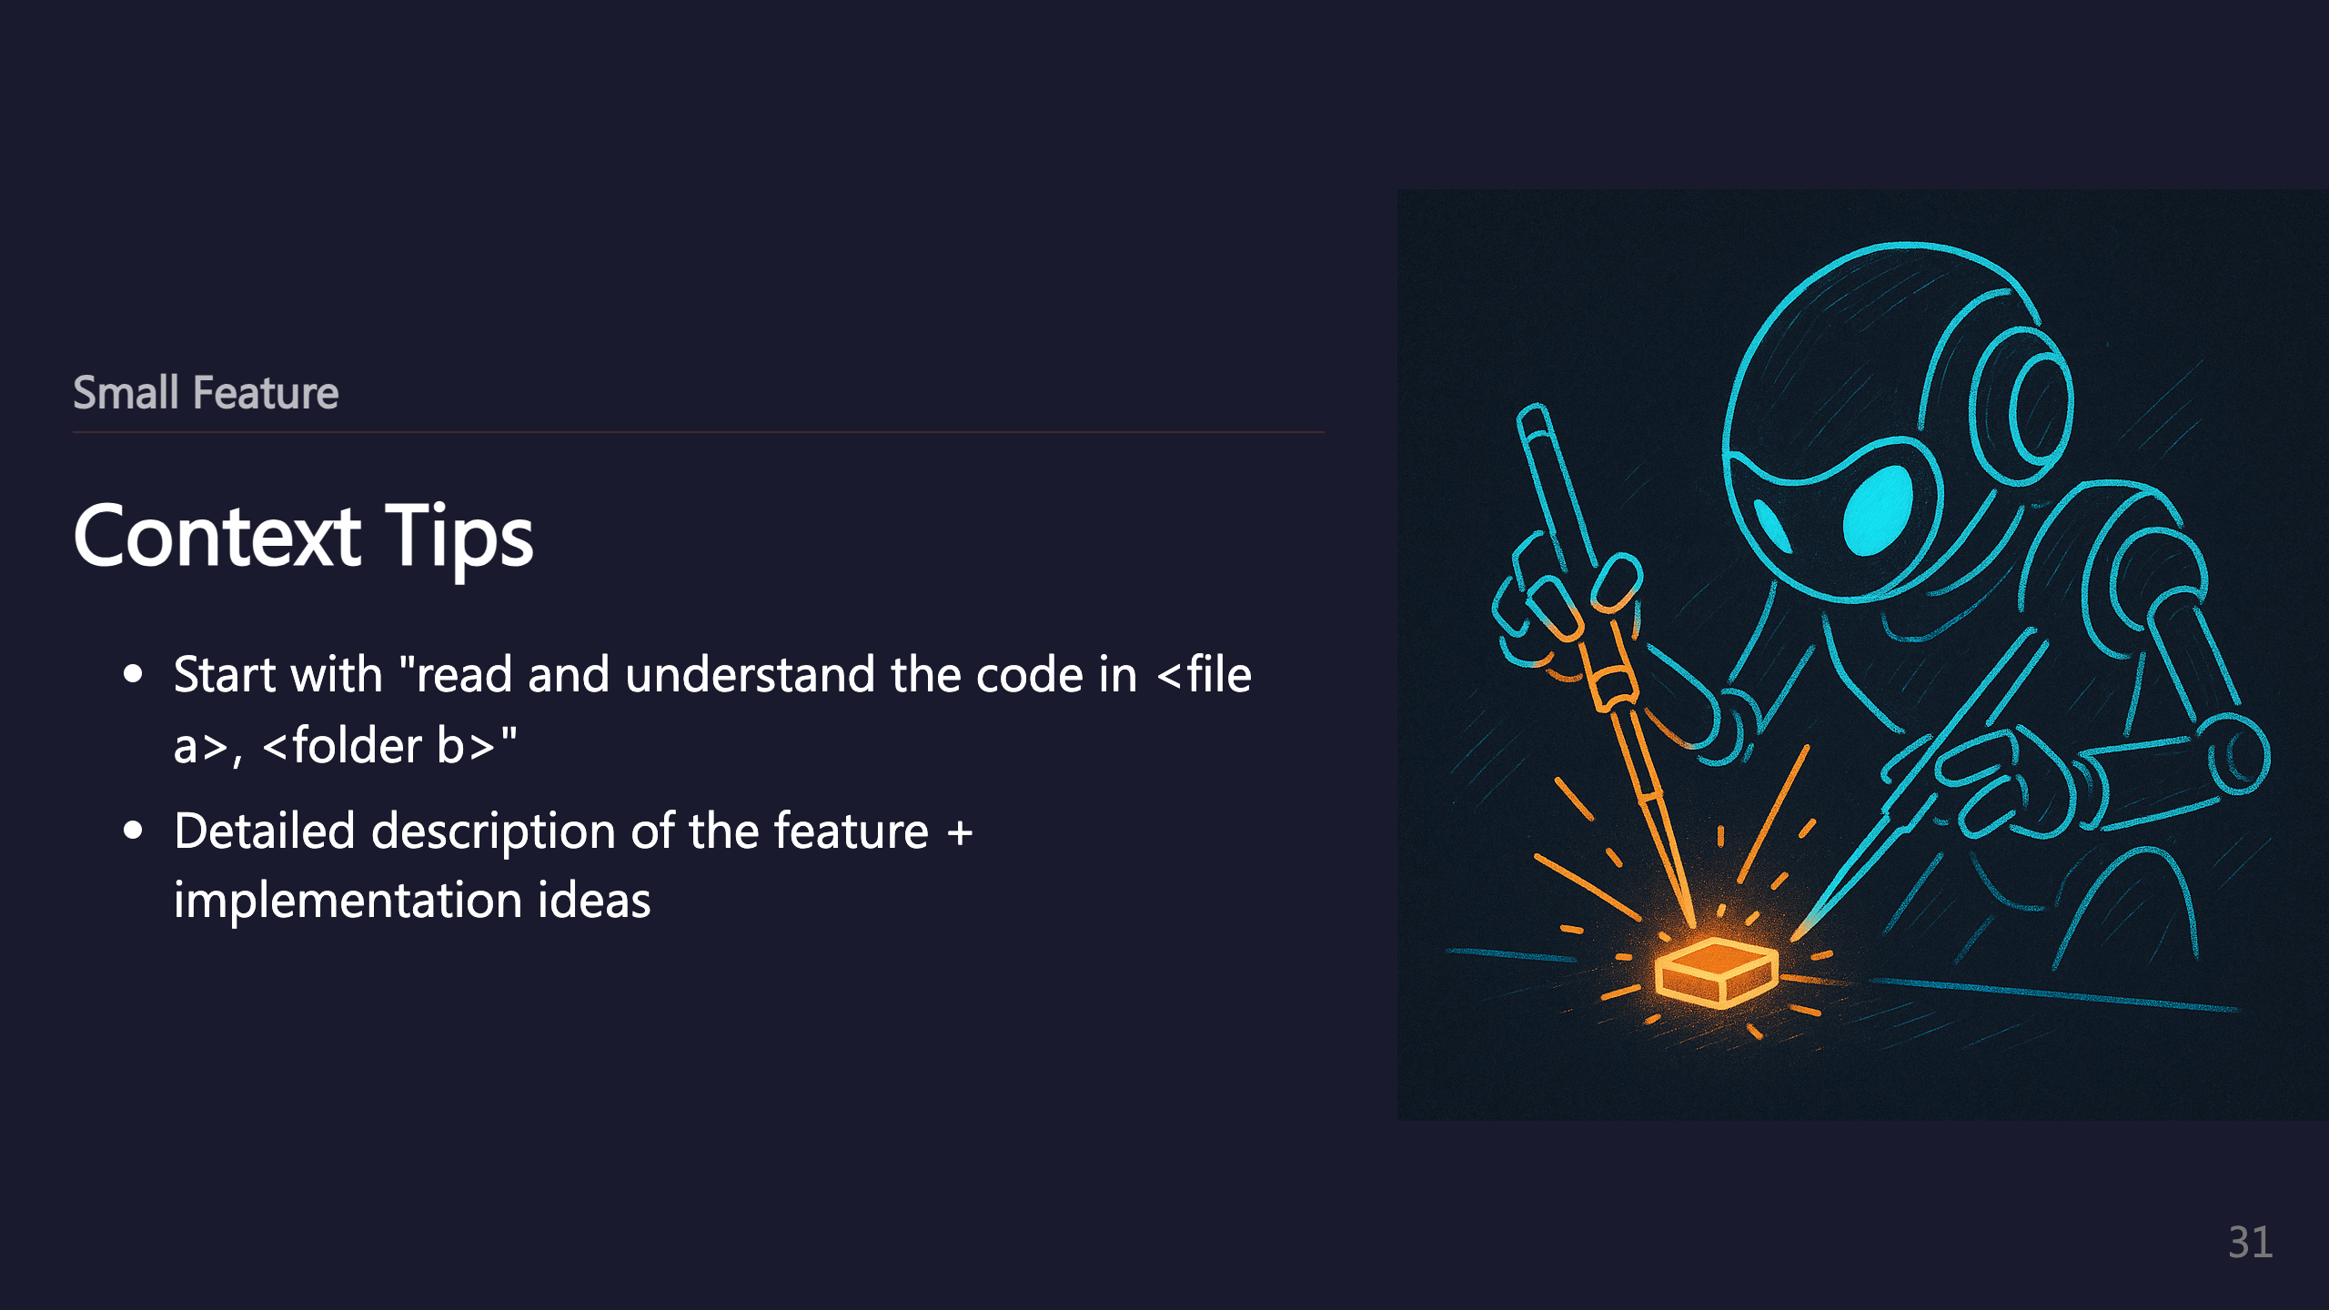

Slide 32
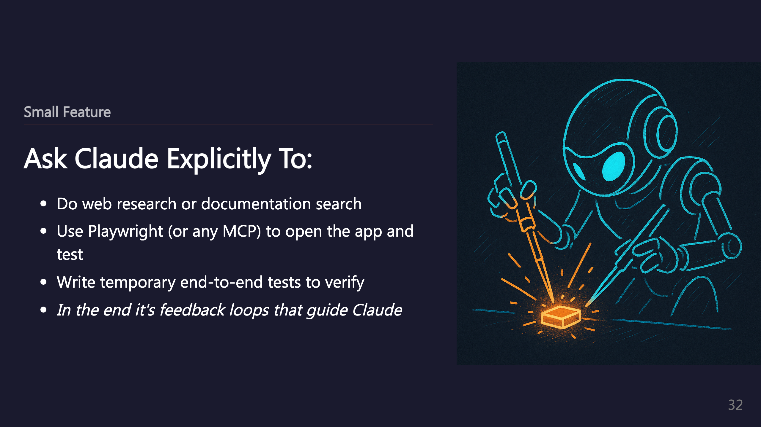
Notes:
_transition: push

Slide 33

Notes:
SECTION: Big Feature (umbrella)

Slide 34


Slide 35
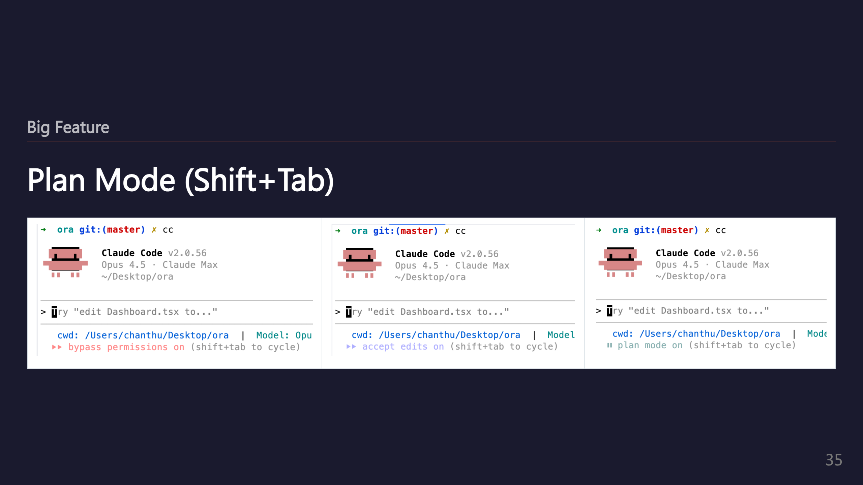
Notes:
_transition: push

Slide 36

Notes:
SECTION: Getting Unstuck

Slide 37


Slide 38


Slide 39
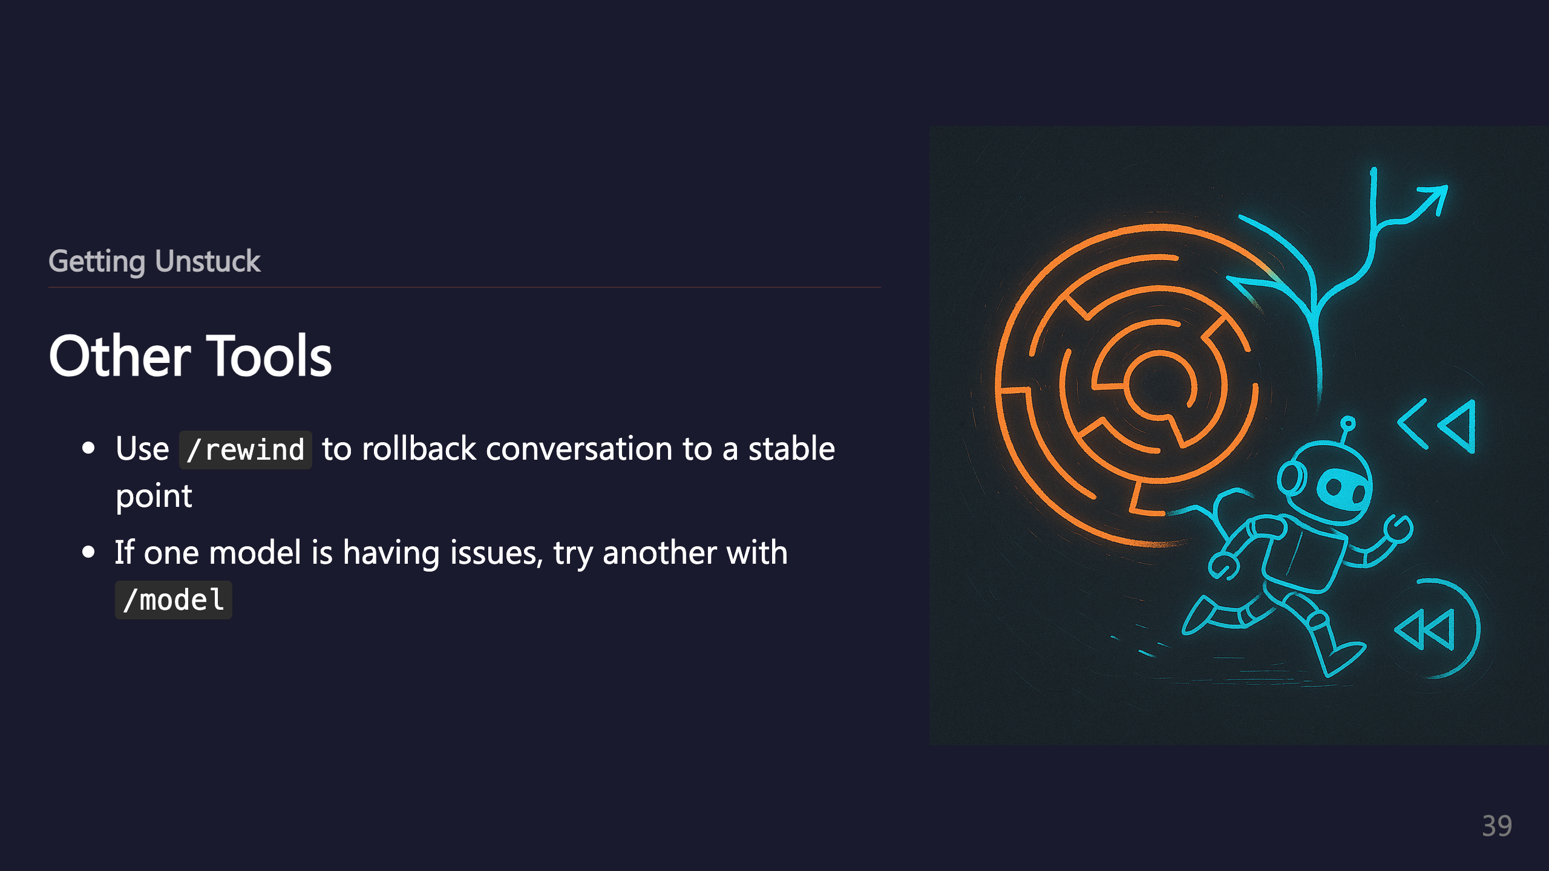
Notes:
_transition: push

Slide 40

Notes:
SECTION: Tips n Tricks

Slide 41
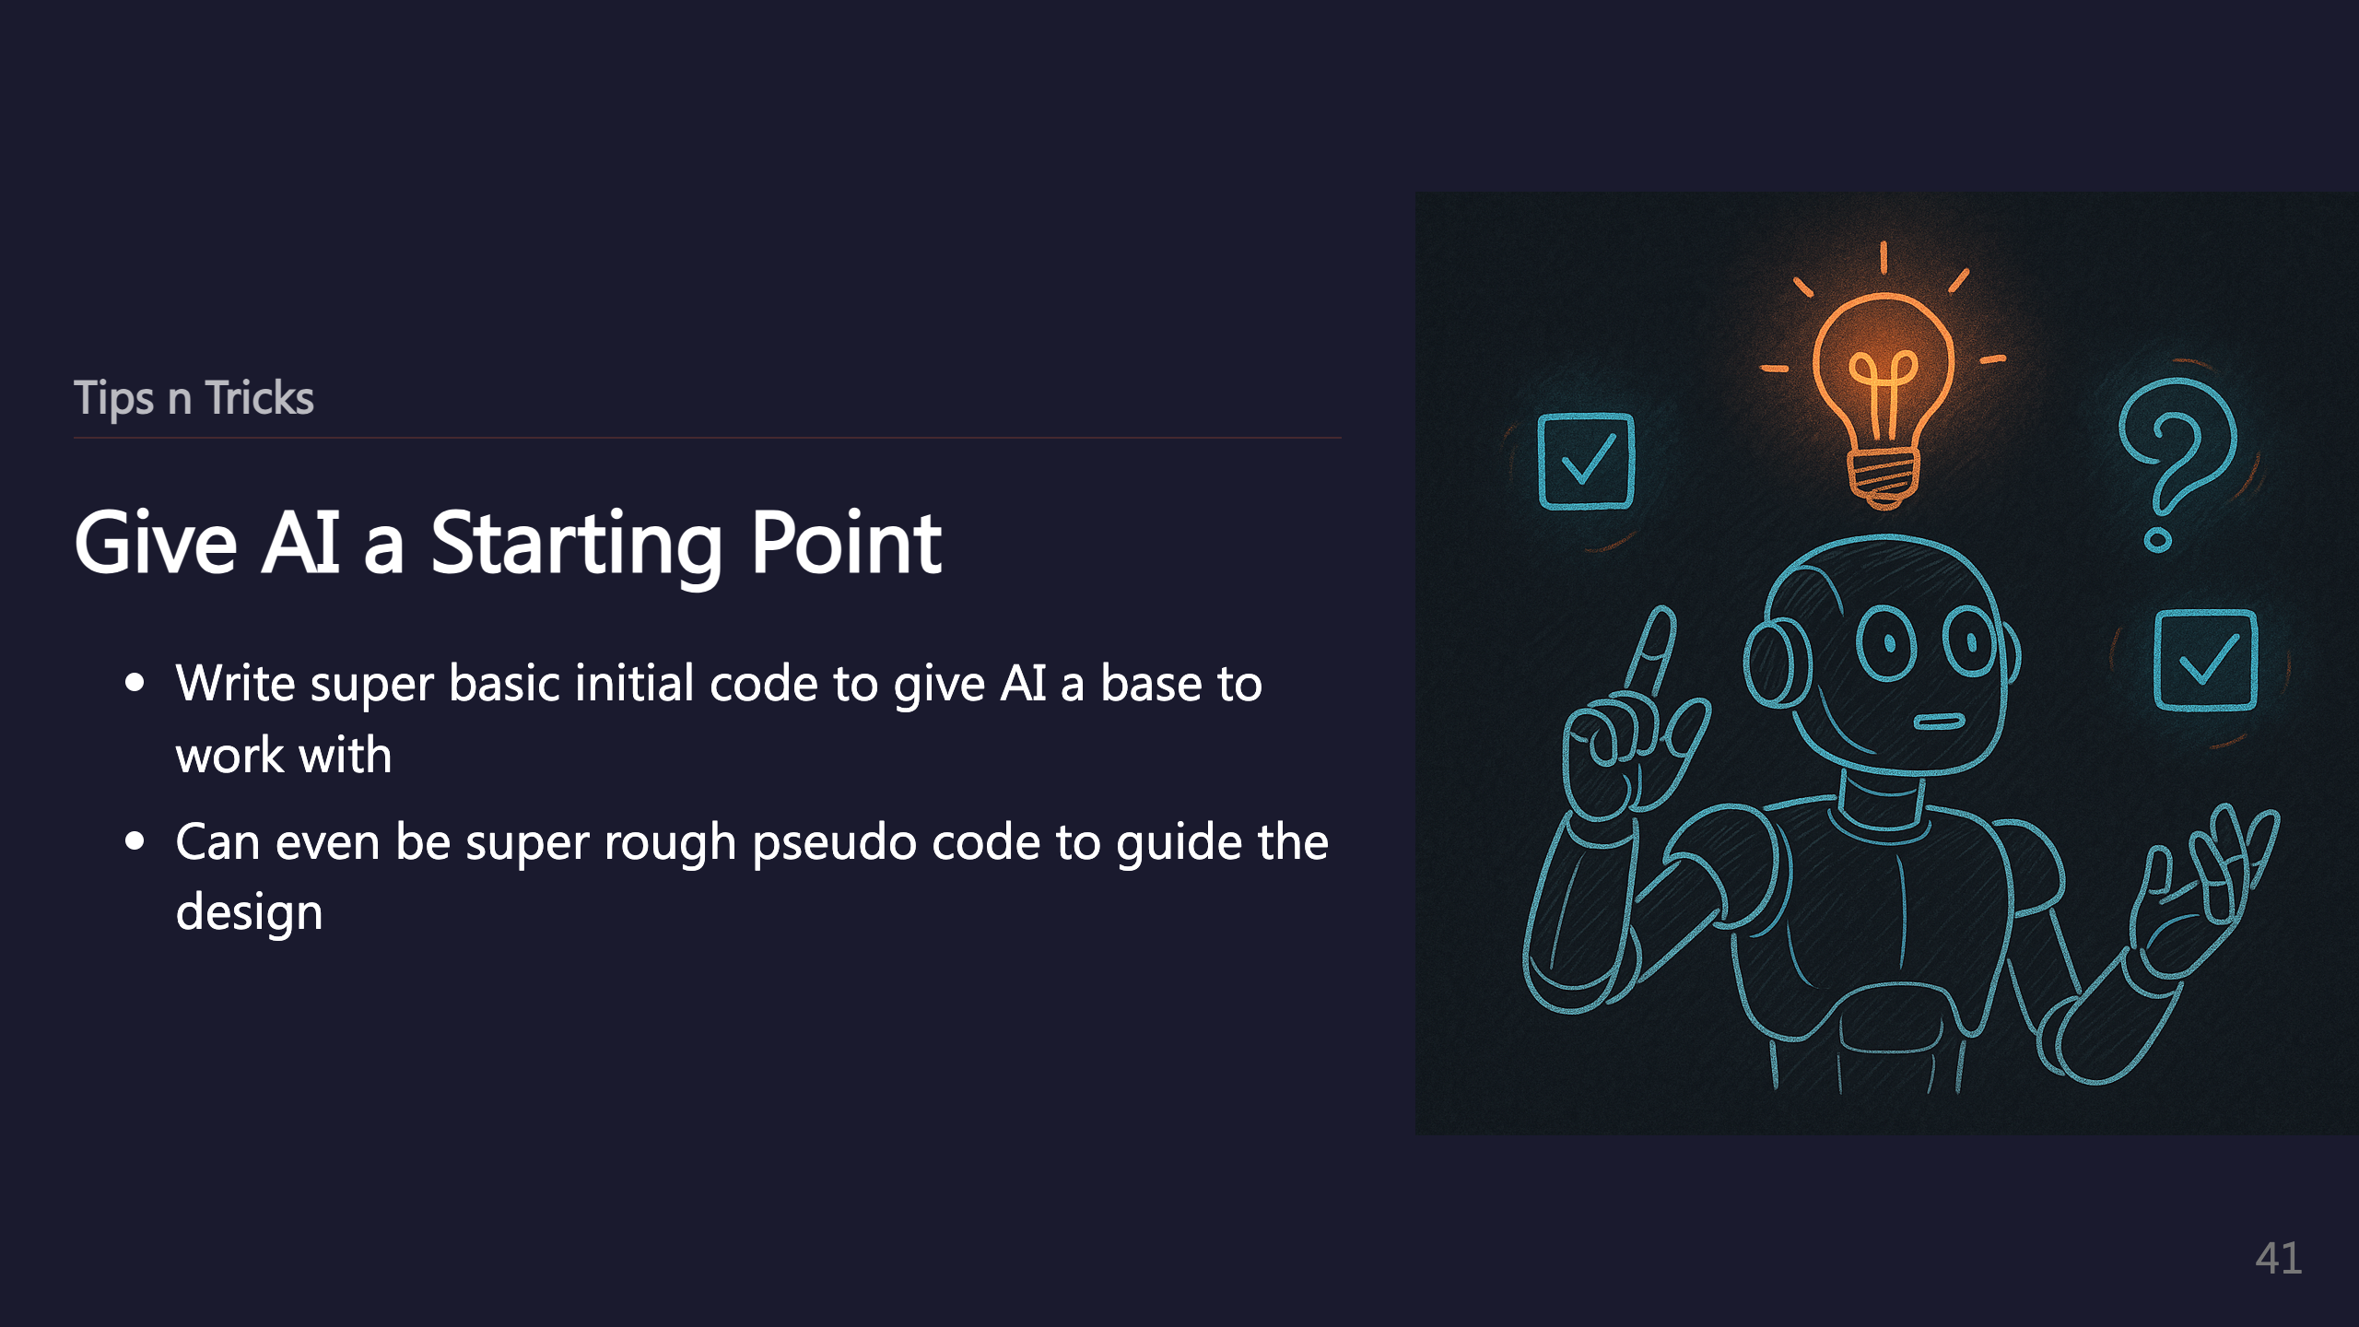
Notes:
_transition: push

Slide 42

Notes:
SECTION: Coming Soon

Slide 43

Notes:
_transition: push

Slide 44

Notes:
SECTION: Conclusion

Slide 45


Slide 46
